Slide 1
Artificial Intelligence in Pathology
By
Chibuike Enwereuzo, MD, MBBS, FCAP, FASCP
Assistant professor of Pathology
SUNY Upstate Medical University
Staff Pathologist and Specialist
GI/Liver Pathology, Hematopathology and Cytopathology
UHS-Wilson Medical Center
Johnson City, New York

Slide 2
Programing vs Machine learning
Programing
Microchips
Written codes
Logic
All scenarios accounted for!
Machine learning
Neural nets
Model trained on data
Decisions/predictions made based on patterns
Adaptable
Not every scenario has to be programmed

Slide 3
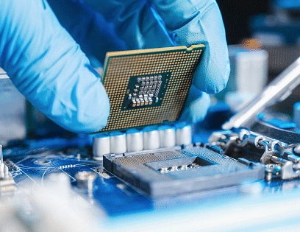
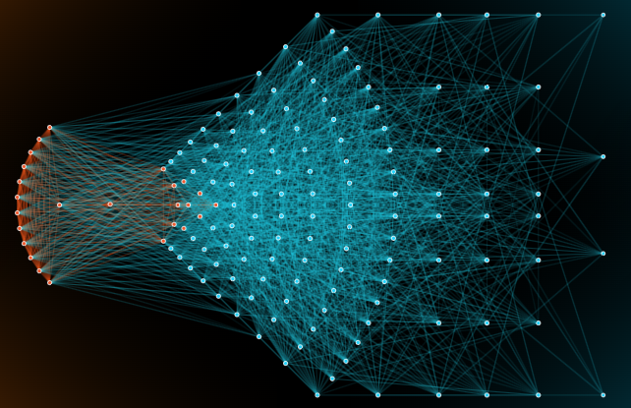
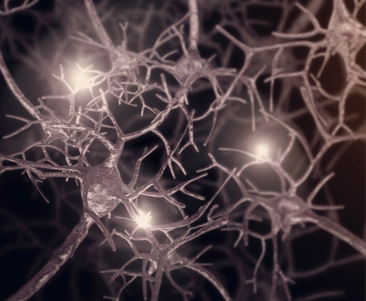
Microchips vs neural nets

Slide 4
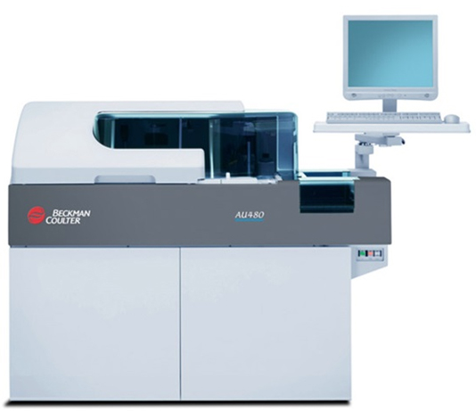
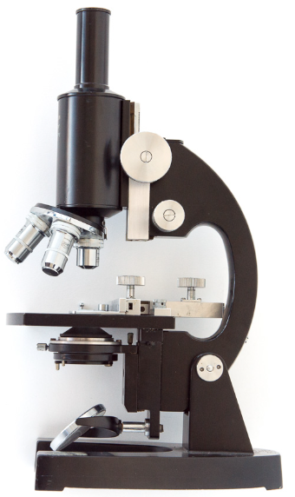
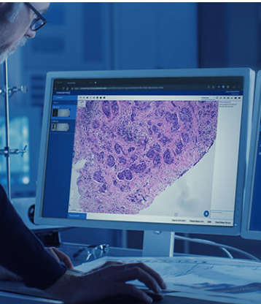
Digital pathology

Slide 5
Why AI?
Shorter review time
Costs
Consistency
No fatigue
No human factor disruption

Slide 6
Radiology vs Pathology
Radiology digitization ahead of pathology
Data size
Storage space
Practical Radiology systems
Accuracy
Digitization always comes first!!!

Slide 7
ANATOMIC PATHOLOGY

Slide 8
Breast Pathology
AI models trained
  Benign vs malignant – Variable accuracy
  In situ vs invasive breast cancer - Exceeds human pathologists
  Nodal metastasis vs negative – Exceeds human pathologists
  Mitosis detection – Falls short of human pathologists’ accuracy
Biomarkers
  HER2/neu IHC – 100% concordance reported
  ER/PR IHC – 90% concordance
  ER/PR on H&E – 84-92% concordance reported
Tumor biology from morphology!
Prognosticate
  Survival and recurrence

Slide 9
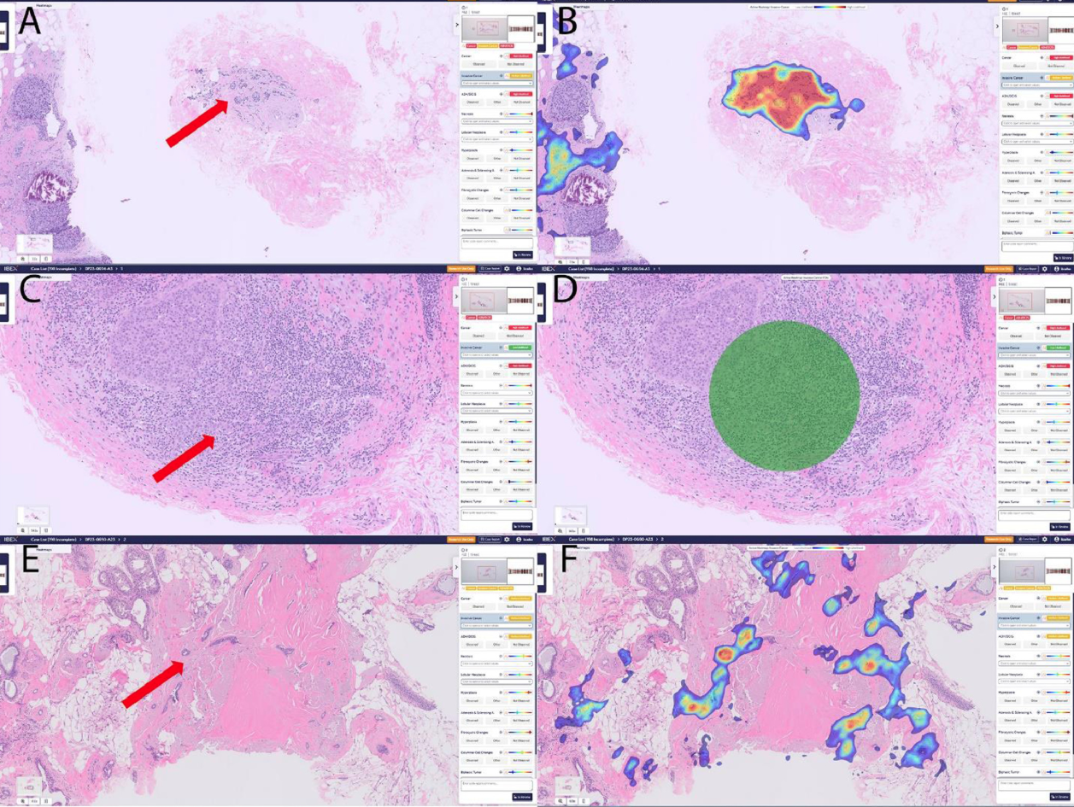
Ohio State University and Ibex Medical Analytics study
Accurately identified invasive and microinvasive carcinomas
Correctly marks a point of interest
Radial scar misdiagnosed as invasive carcinoma*

Slide 10
Breast Pathology
No FDA approved fully autonomous diagnostic models
Experimental models may be used as adjuncts
Semiquantitative evaluation of biomarkers
Grading
Lymph node metastasis
Report pre-population
Currently, may improve workload
Off-label predictions
  Predicting prognosis and therapy response
  Predicting potential molecular changes

Slide 11
Prostate Pathology
1/9 US men will develop prostatic cancer
Most will get a 12/18-core-biopsy of the prostate
Interest driven by
  Huge volume of material
  Shortage of pathologists
  High false negative rate- up to 8%
Limited to detection and grading prostatic adenocarcinoma
  Model vs general pathologist
    Grading: AI=71.7% vs Human=58% (p<0.001)
    Tumor recognition: AI=94.3% vs Human =94.7%
Promising entry into clinical practice

Slide 12
Paige Prostate
FDA approval for IVD diagnosis of prostate cancer
Identifies cancers easily overlooked by human pathologists
May obviates need for serial tissue levels
70% reduction in detection errors

Slide 13
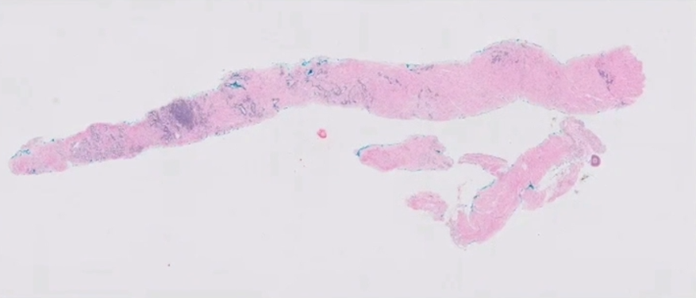
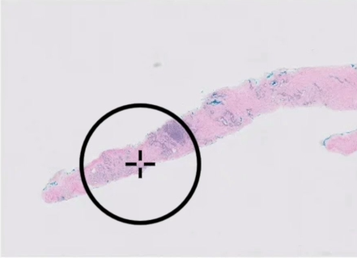
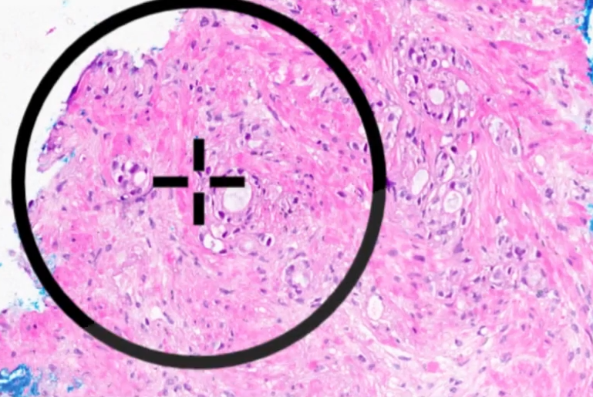
Paige Prostate

Slide 14
Practical uses in prostate pathology
Second eye
Enhanced gleason’s scoring
Quantifying cancer features
Identify patterns (eg PNI, cribriforming, intraductal ca etc)

Slide 15
Lung Pathology
No FDA approved product in clinical use
Research still ongoing
Using H&E slides alone, AI models can:
  Prognostication-(short and long term survivors)
  Molecular signature/ gene mutation (including EGFR, KRAS & TP53)
  PDL-1 status and response to Nivolumab
Adenocarcinoma vs squamous cell carcinoma

Slide 16
Colon Pathology
No FDA approved fully autonomous diagnostic models
Active research with interesting results
  Differentiating polyp types
  Histologic subtypes of adenocarcinoma
  Prognostication
  MicroSatellite Instability
  Molecular signature

Slide 17
AI Solutions Independent of Cancer Cells
General prognostication using tumor/stromal ratio
Prognostication based on stromal component evaluation
Tumor infiltrating lymphocytes
Tumor microenvironment
Response to immunotherapy

Slide 18
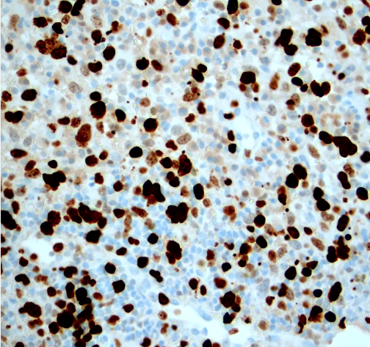
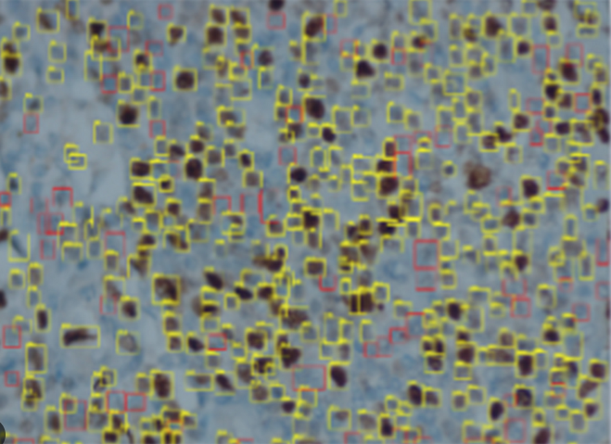
Ki-67 index

Slide 19
Automated video pap screening
Hologic Genius Digital Diagnostics System
Techcyte SureView® Cervical Cytology System
IARC-developed AI

Slide 20
Hologic Genius Digital Diagnostics System
FDA clearance in February 2024
Key components
  Genius Digital Imager
    WSI (all cells captured!)
  Genius Cervical AI algorithm
    Deep learning AI analyze every single cell
    Identifies and compiles "objects of interest“
    Organized gallery for review by a cytologist or pathologist
  Genius Image Management Server
    Central server
    Stores, retrieves, and transmits image data and case information
  Genius Review Station
    High-resolution monitor and dedicated software
    Cytologists and pathologists review the AI-generated gallery of OOIs

Slide 21
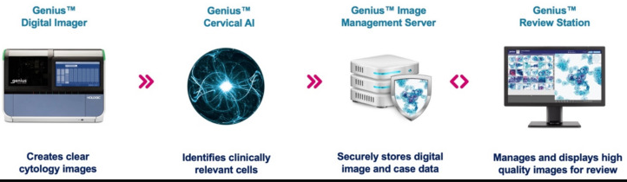

Slide 22
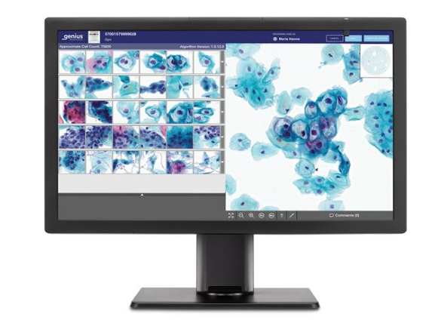

Slide 23
Other cervical cancer screening platforms
Techcyte SureView® Cervical Cytology System
  Clinically available in Europe
  Similar to the Hologic in operation
IARC-developed AI
  Developed by the International Agency for Research on Cancer (IARC)
  AI interpretes gross image of cervix
  Targets resource poor settings
  Does not require internet, battery powered
  Outperforms pap/visual inspection
  Validation and field testing ongoing in many countries

Slide 24
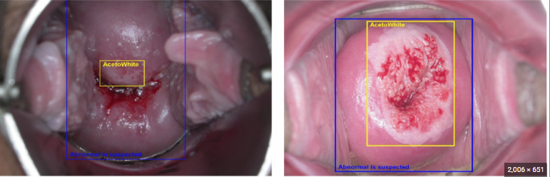
IARC-developed AI

Slide 25
CLINICAL PATHOLOGY

Slide 26
AI in Clinical Pathology
Automation laborious tasks
Increased Accuracy
Enhanced Efficiency
Improved Public Health/Epidemic mitigation:
Reduced Turnaround Time

Slide 27
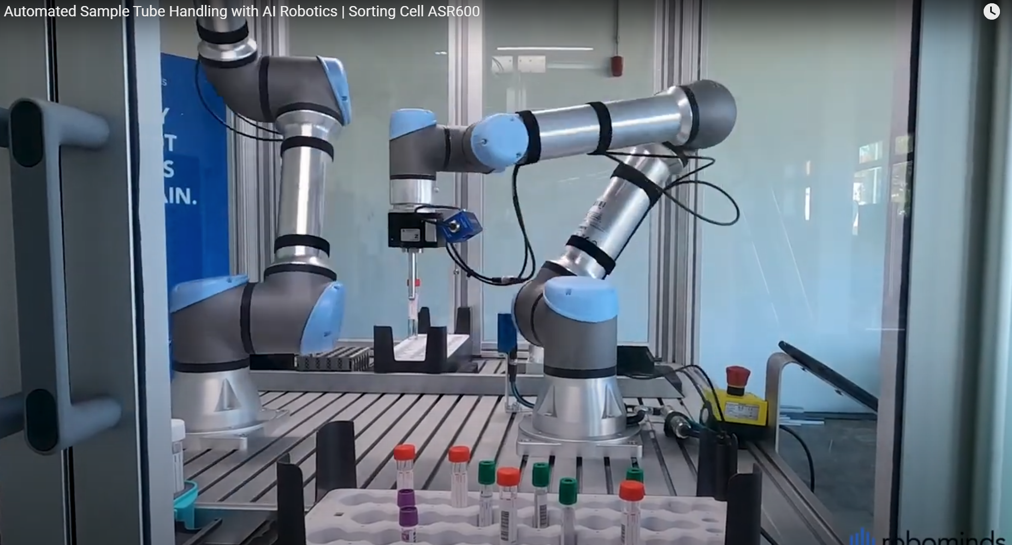
ASR600 AI Specimen handling system

Slide 28
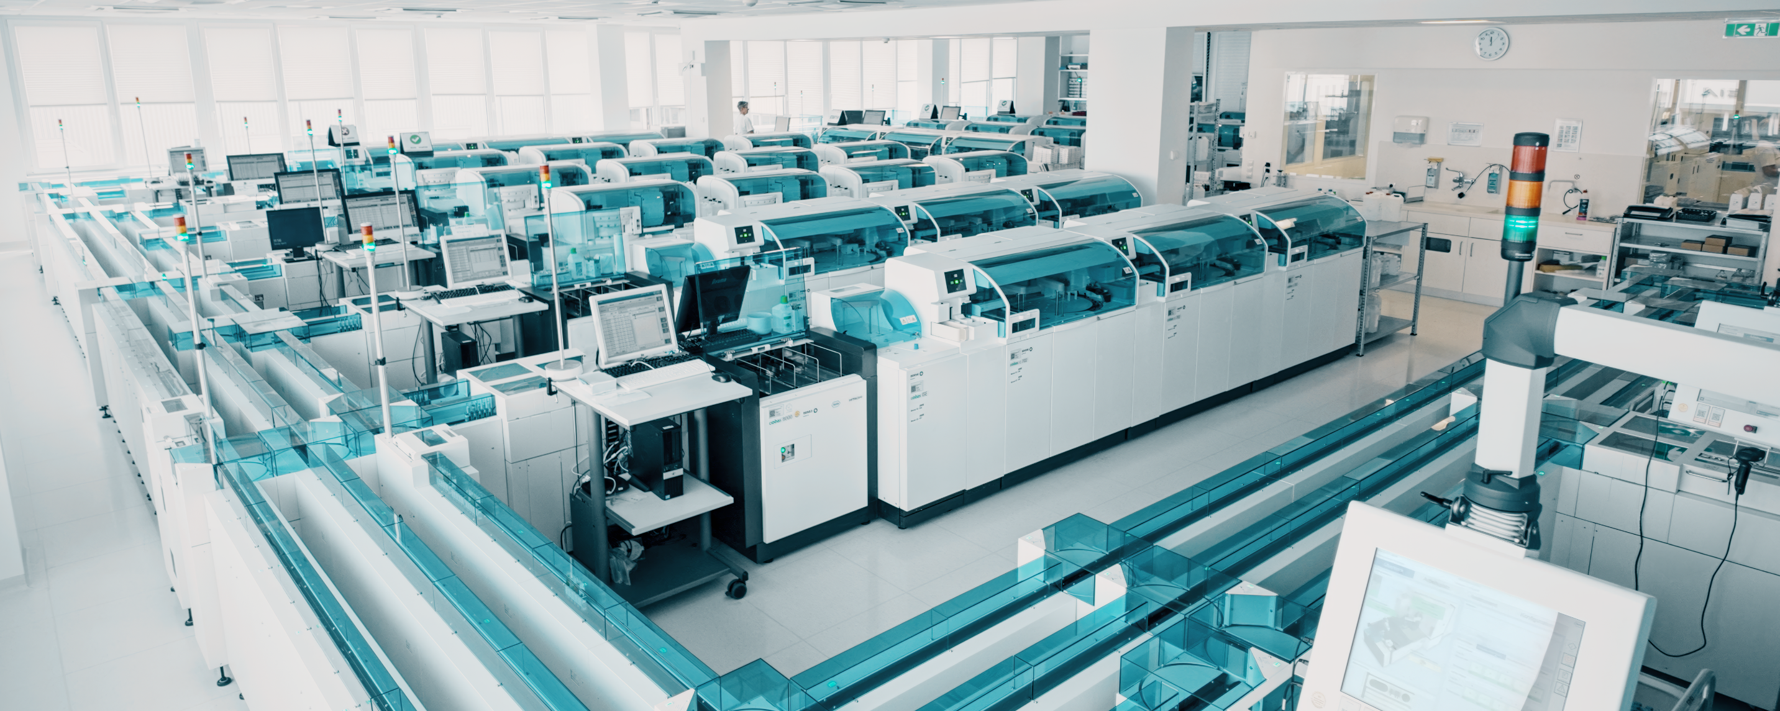
Automated work flow

Slide 29
Microbiology

Slide 30
WASPLAB®
Integrated microbiology system
Key components include
  WASP® (Walk-Away Specimen Processor)
    Automated processing, plating, streaking, and slide preparation
  Automated Incubators:
    Controlled environment for culture growth
    High-capacity image acquisition
    Storage.
  Digital Microbiology & PhenoMATRIX
    Captures images of cultures
    Allows remote review and analysis of growth
    Eliminates need for physical examination
  AI and Software:
    AI analyze culture images
    Results integrated with LIS

Slide 31
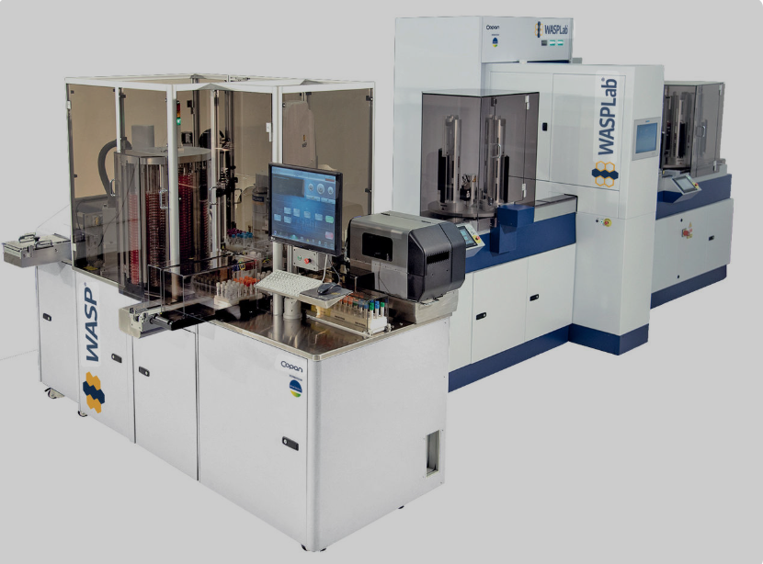
WASPLAB®

Slide 32
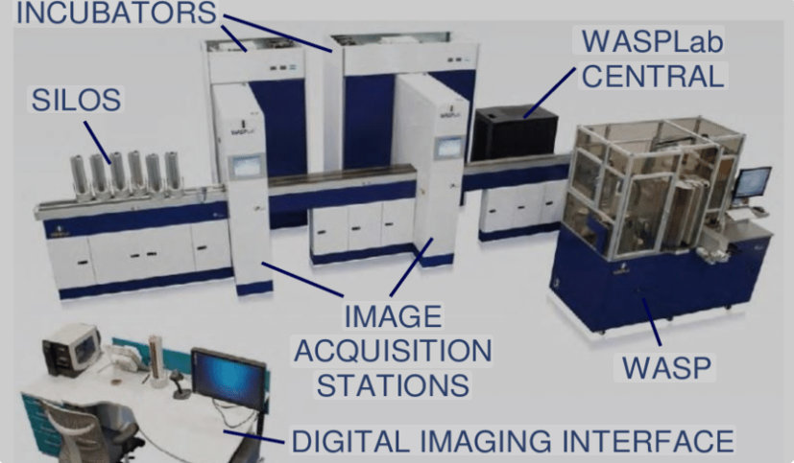
WASPLAB®

Slide 33
AI automated microbial identification
Image-Based Identification
Genomic and Molecular Data Analysis
Integration with Automation Platforms

Slide 34
Image-Based Identification systems
CNNs (Convolutional Neural Networks)
  Morphology based identification
  Colony morphology and counts
Deep Colony:
  Speciation using colony morphology
  Simulates microbiologist evaluation of plate colonies
  Matched experts’ judgement in 95.4%
EasySort AUTO:
  Identifies, sort, and exports single microbial cells
  Further analysis, such as single-cell sequencing
Most still investigational
Currently limited in clinical use

Slide 35
Biochemical based identification
Compares biochemical reactions to large databases
VITEK 2 (e.g BioMérieux's)
  Uses wells in Vitek cards containing dehydrated substrate
  AI interprets results colorimetric and turbidimetric changes
MicroScan system (eg Thermo Fischers)
  AI interprets results from biochemical reaction panels
Biolog Omnilog
  Microplates test microbe’s ability to use carbon sources
  AI analyze metabolic fingerprints/respiration patterns
  Identifies bacteria, yeasts, and fungi
AI-assisted biosensing
  Uses microspheres to perform biochemical analyses
  AI analyze and detects targets

Slide 36
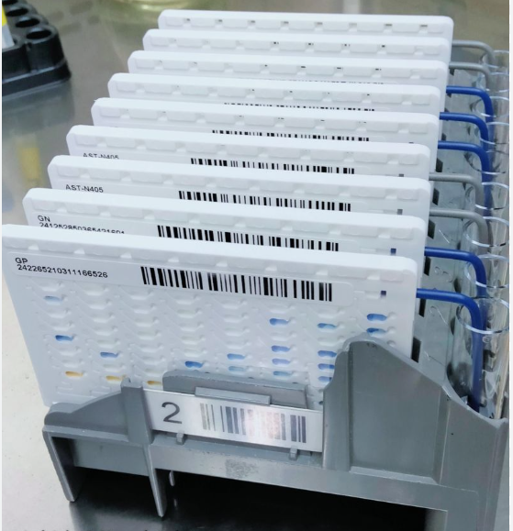
VITEK 2 cards

Slide 37
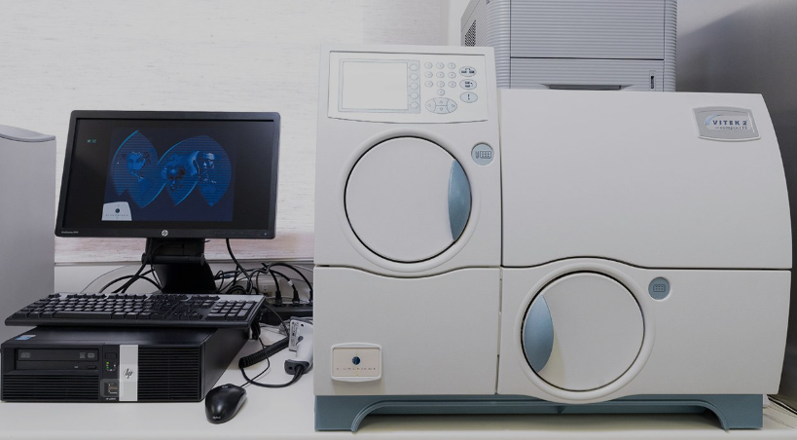
VITEK 2 automated analyzer

Slide 38
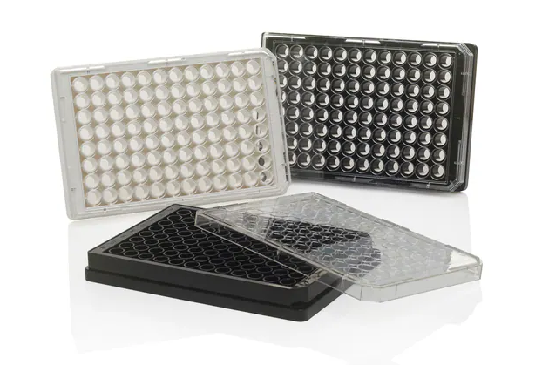
Microscan plate

Slide 39
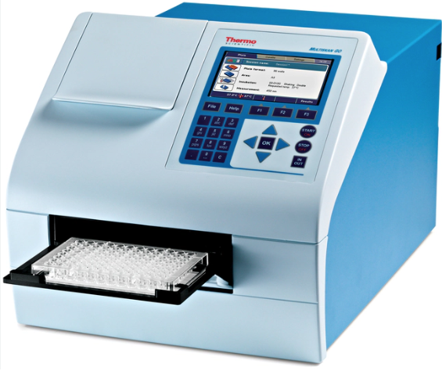
Thermo Fisher's MicroScan

Slide 40
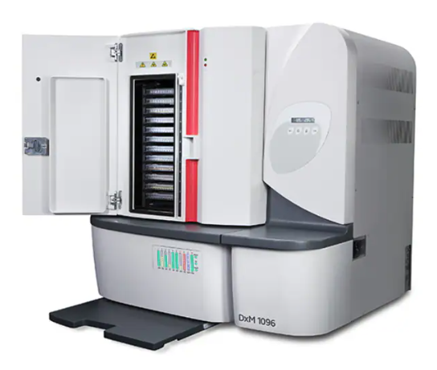
Beckman Coulter Microscan

Slide 41
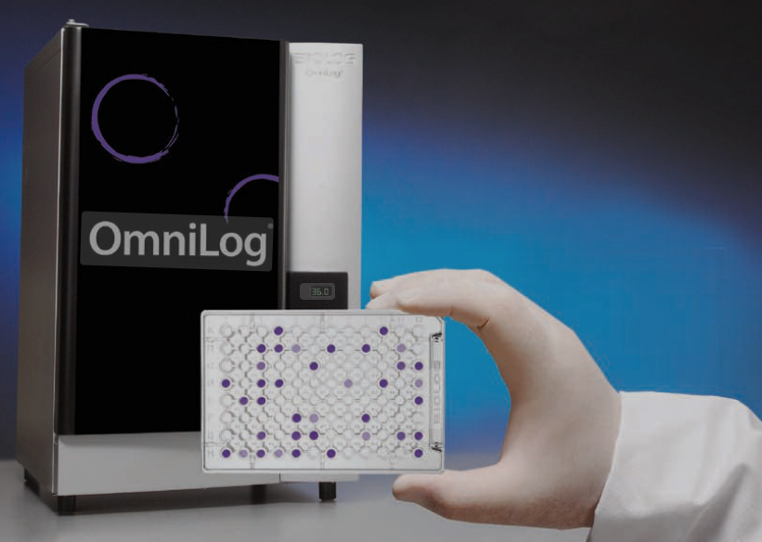
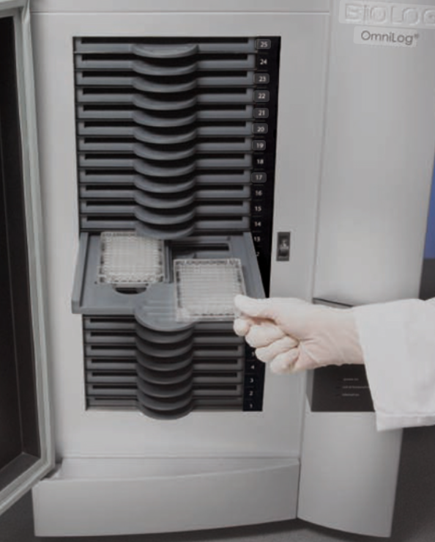
Biolog Omnilog

Slide 42
Microbial molecular identification systems
DNA Extraction
Amplification (PCR)
Sequencing:
Analysis and database comparism
May identify sub-strains and resistance profile!

Slide 43
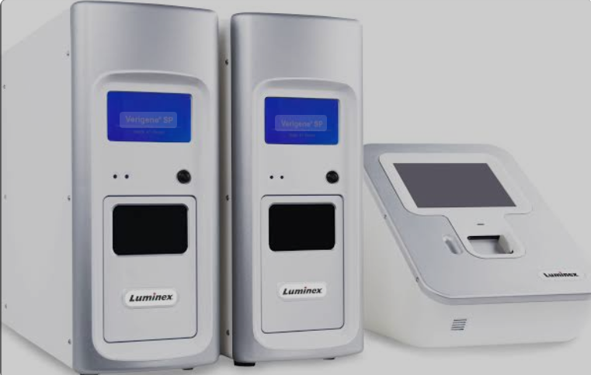
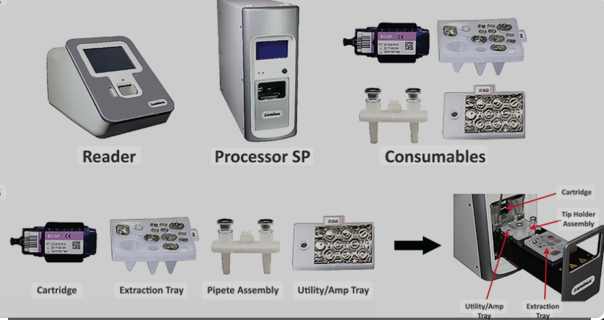
Verigene systems

Slide 44
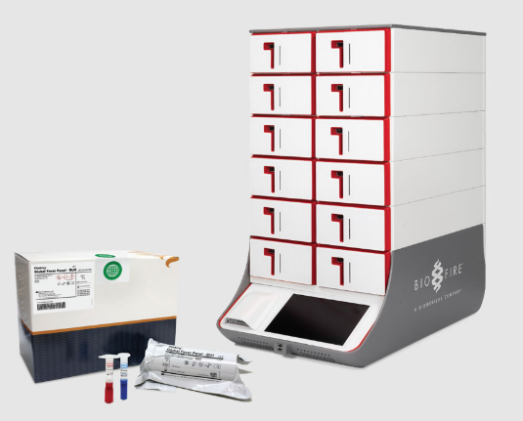
The Biofire® Filmarray® Torch System

Slide 45
Microbial Mass Spectrometry
How it works
Sample Preparation:
Laser strikes Ionization
Separation & Detection
Spectrum Generation
  Unique protein fingerprint
Database comparism and Identification
May identify sub-strains and resistance profile!

Slide 46
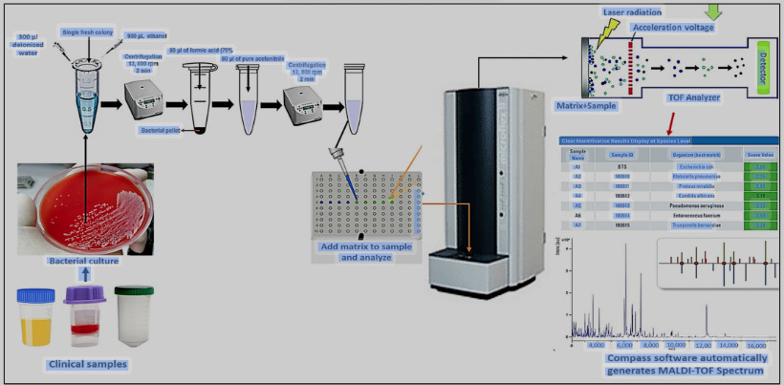
MALDI-TOF MS

Slide 47
Clinical Chemistry

Slide 48
AI in Clinical chemistry
Pre-analytical Phase
Analytical Phase
Post-analytical Phase

Slide 49
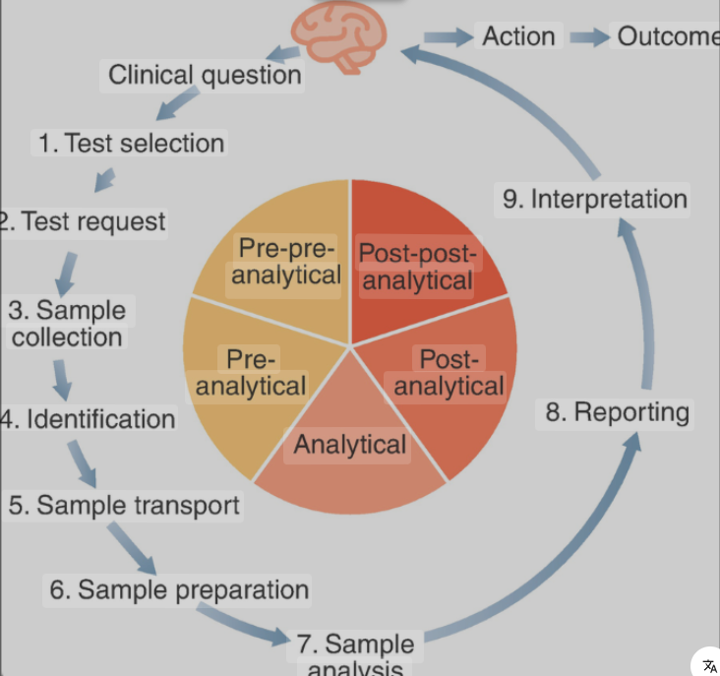

Slide 50
Pre-analytical phase-Test prescription
As always, digitization comes first!
Many US labs already digitized and integrated with EHR
Automated systems do most pre-analytics
OCR useful where integration is lacking
Optical Character Recognition (OCR)
  Often uses AI and machine learning
  Automates data entry in requisition forms and specimen labels
    Patient demographics, test orders, and insurance details etc
    Can rapidly read printed patient info on specimen label
    Cross reference with LIS and flag discrepancies (e.g mislabels)
  Automatically routes tubes to correct analytical instruments
  Minimizes human errors
  Improves efficiency.

Slide 51
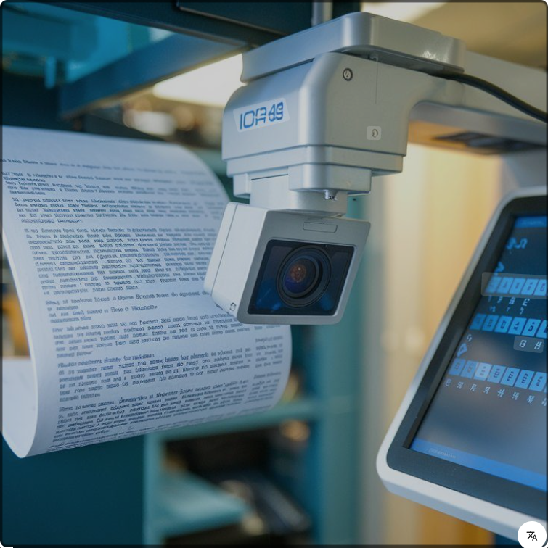


Optical Character Recognition (OCR)

Slide 52
Pre-analytical phase-Specimen collection
Automated venipuncture systems eg Vitestro and MagicNurse
High first-stick success rates.
Imaging guidance:
  Uses near-infrared light and ultrasound imaging
  Visualizes vessels and determines depth, size, and location.
Artificial intelligence:
  Compares visual data against vein anatomy database
  Selects the most suitable and accessible vein for the procedure.
Robotic needle insertion:
  Robotic arm precisely inserts the needle into the chosen vein
  Real-time imaging continues to guide the robot
  Adjustments made to account for minor patient movements.
Automated sample handling:
  Fill and standardize the blood collection tubes
  Sample quality evaluation
    Icterus, lipemia, hemolysis etc
  Some have on-board centrifuge for rapid blood analysis

Slide 53
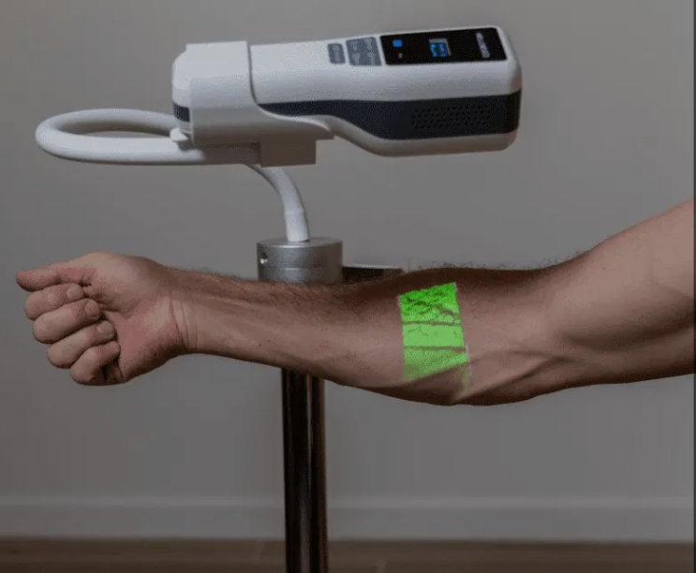
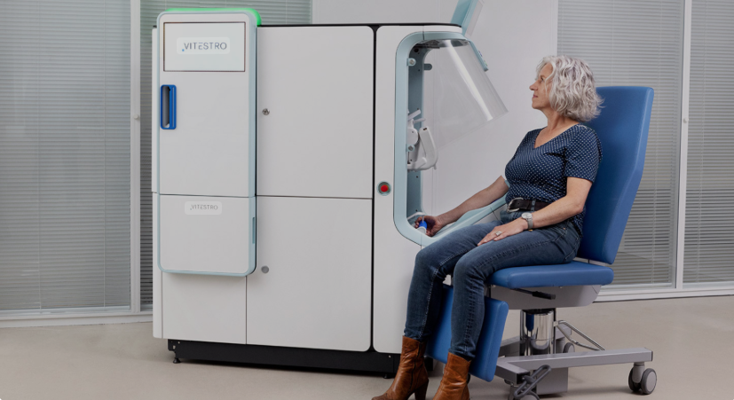
Pre-analytical phase-Specimen collection
Vein finder
Automated venipuncture

Slide 54
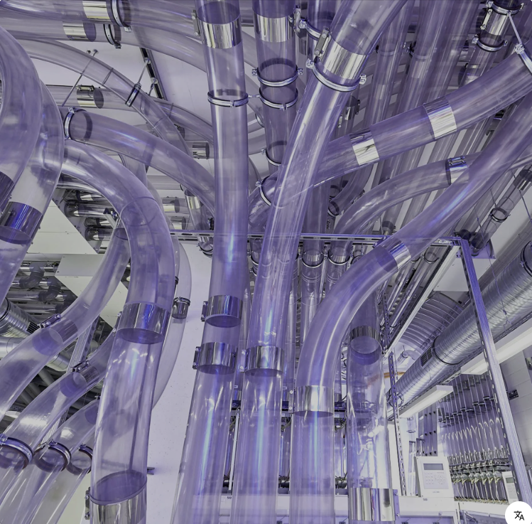
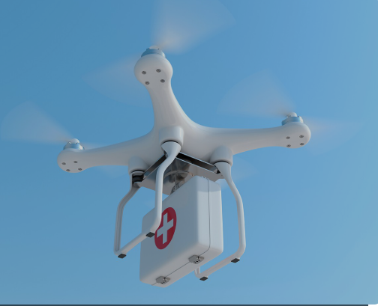
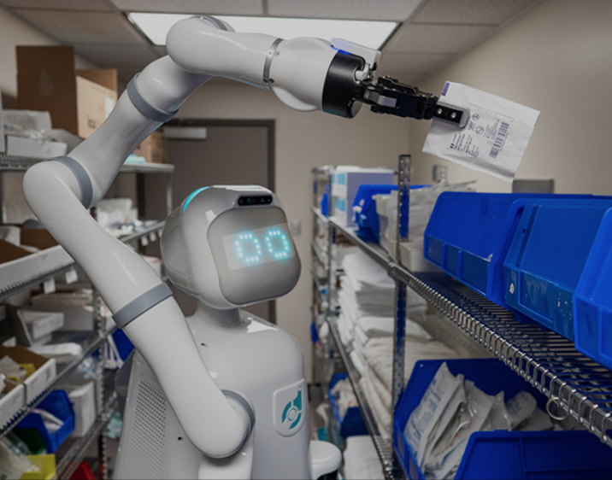
Pre-analytical Phase-Sample Transportation
Pneumatic tubes
Drones
Robots

Slide 55
Analytical Phase
Automated systems with AI already built into analyzers and LIS
Complex data analysis
  Analyze data from different analytic method
  May identify patterns and anomalies missed by human
Enhanced quality control
  Flag instrument issues faster
  Identifies deviations from normal, trends, and other QI issues
Improved interpretation
  Accuracy and speed of interpreting results
  Spectral data processing for compound identification
  E.g recognizing biomarker profiles that indicate health status.
Workflow automation
  Data flagging and initial result review
  Frees up lab professionals to focus on more complex cases.

Slide 56
Post-analytical Phase
Automated result interpretation and reporting
  More comprehensive reports that are easier for clinicians to understand
Large scale automatic result validation
  Speeds up result release
Critical value management
Error detection and correction
  Detects errors, discrepancies between different test results etc
Data integration and clinical correlation:
  Provides a more comprehensive picture of patient health
Personalized reporting
  Tailors reports to individual patient (precise medicine)
Workflow and data management

Slide 57
Hematology

Slide 58
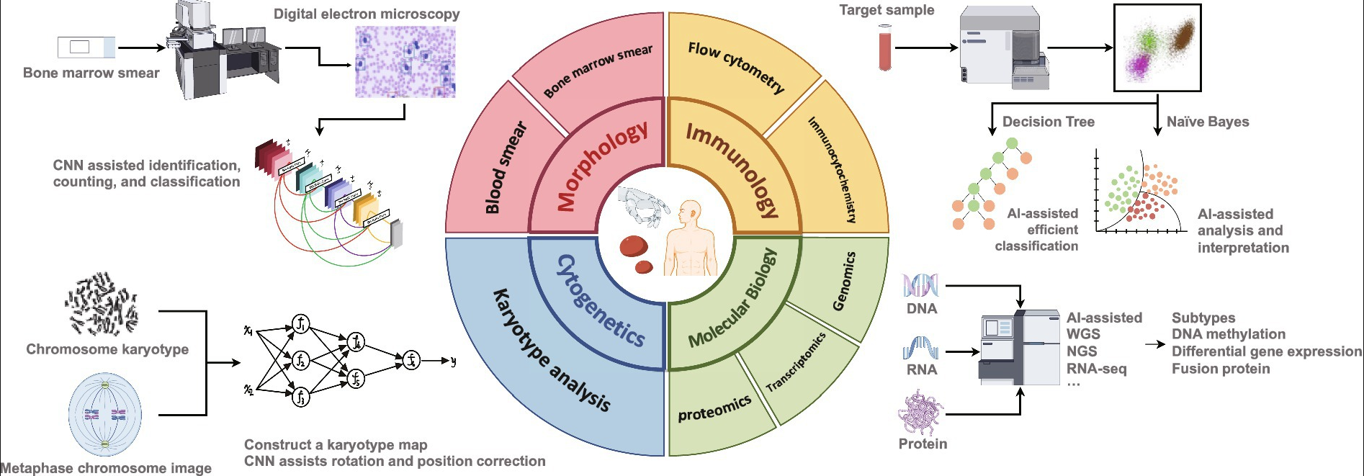
Overview of AI application

Slide 59
Morphology-Digital pathology
Automated systems do counts
Prepare and stain blood and bone marrow films
Slide scanners digitize, analyze and store hematology slides
Identifies blood cells anomalies with high precision.
Identifies malignant cell populations
Allows for remote consultation

Slide 60
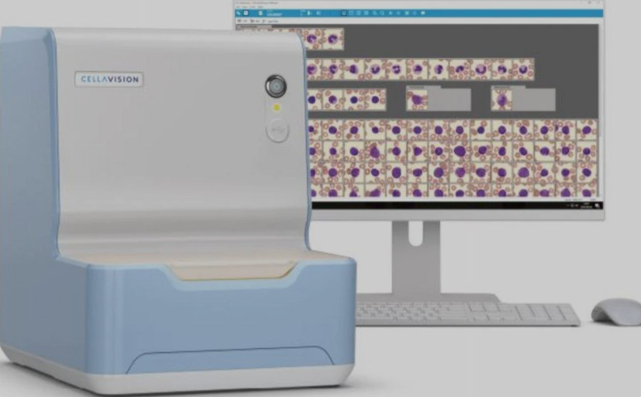
CellaVision system by Beckman Coulter

Slide 61
Immunology- flow cytometry
Experinmental, mostly technical
DeepFlow™
  Trained on over 300,000 expert-diagnosed clinical cases
  Demonstrated 100% sensitivity and 98.3% specificity
  Automated data management, storage, and diagnostic workflow
  Auto gating, classification and report generation
  Analyze 100k events in 5 secs
Smart Cyto Flow
  Automates complex flow cytometry data
  Automatically cluster cells
  Identify specific populations (eg MRD)

Slide 62
Cytogenetics
Automated karyotyping
ASI (Applied Spectral Imaging)
  Automated scanning, analysis and karyogram
  Banding, anomaly detection
  FISH
  LIS integration
BioView
MetaSystems

Slide 63
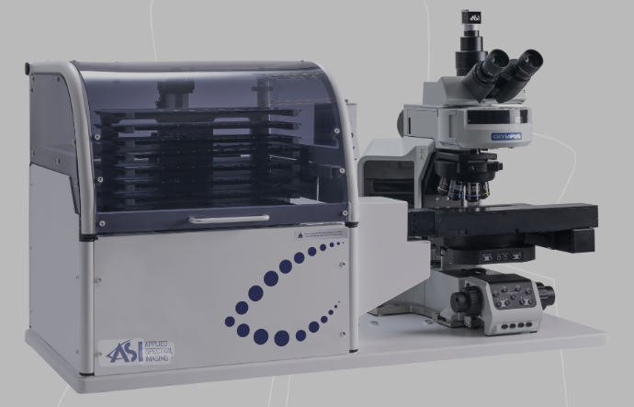
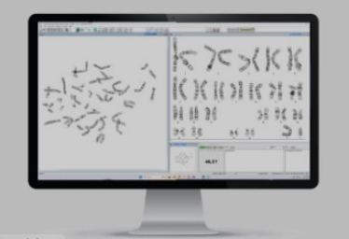
ASI (Applied Spectral Imaging)

Slide 64
Molecular biology
Automated DNA extractions
AI sifts through molecular lesions
References database
Hematologic malignancy classification and subtyping
Personalized medicine

Slide 65
Future Perspetives
Currently still limited
  Teaching, research & QA
WSI <30% of institutions
Still lacks robustness and general applicability
  Performance depends on training data volume and quality
  20% drop in performance when parameters change
  Variations in staining procedures, tissue types and scanners
Calls for open source data/central repository
  Like Cancer Genome Atlas, the Cancer Imaging Archives etc

Slide 66
References
Shafi S, Parwani AV. Artificial intelligence in diagnostic pathology. Diagn Pathol. 2023 Oct 3;18(1):109. doi: 10.1186/s13000-023-01375-z. PMID: 37784122; PMCID: PMC10546747
Försch S, Klauschen F, Hufnagl P, Roth W. Artificial Intelligence in Pathology. Dtsch Arztebl Int. 2021 Mar 26;118(12):194-204. doi: 10.3238/arztebl.m2021.0011. PMID: 34024323; PMCID: PMC8278129.
Ghaffar Nia N, Kaplanoglu E, Nasab A. Evaluation of artificial intelligence techniques in disease diagnosis and prediction. Discov Artif Intell. 2023;3(1):5. doi: 10.1007/s44163-023-00049-5. Epub 2023 Jan 30. PMCID: PMC9885935.
Lancellotti C, Cancian P, Savevski V, Kotha SRR, Fraggetta F, Graziano P, Di Tommaso L. Artificial Intelligence & Tissue Biomarkers: Advantages, Risks and Perspectives for Pathology. Cells. 2021 Apr 2;10(4):787. doi: 10.3390/cells10040787. PMID: 33918173; PMCID: PMC8066881.
Mercan E, Mehta S, Bartlett J, Shapiro LG, Weaver DL, Elmore JG. Assessment of Machine Learning of Breast Pathology Structures for Automated Differentiation of Breast Cancer and High-Risk Proliferative Lesions. JAMA Netw Open. 2019 Aug 2;2(8):e198777. doi: 10.1001/jamanetworkopen.2019.8777. PMID: 31397859; PMCID: PMC6692690.
Parvin Mohseni, Abozar Ghorbani: Exploring the synergy of artificial intelligence in microbiology: Advancements, challenges, and future prospects, Computational and Structural Biotechnology Reports, Volume 1, 2024

