Slide 1
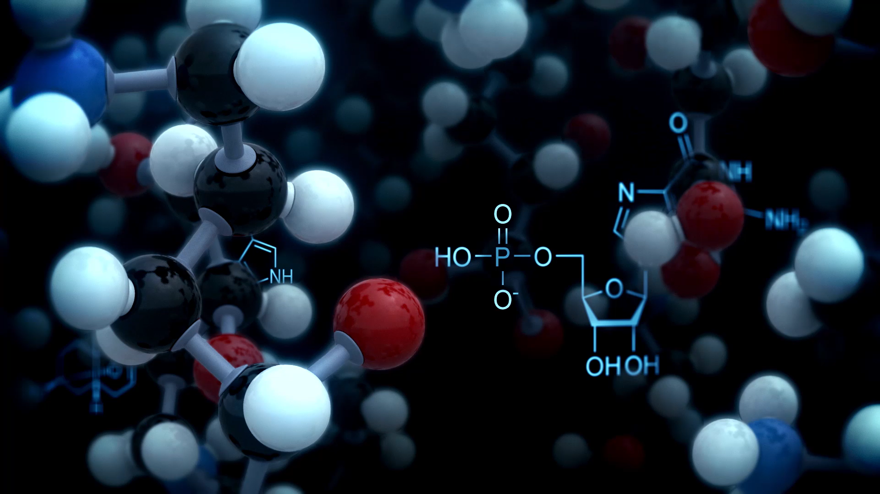
Artificial Intelligence in Drug Repurposing
Prof. Godsent C Isiguzo
MD, PhD, FWACP,, FNCS, FESC, ISHF
Alex Ekwueme Federal University/University Teaching Hospital Abakaliki

Slide 2

Conflicts of interest
Nothing to declare

Slide 3
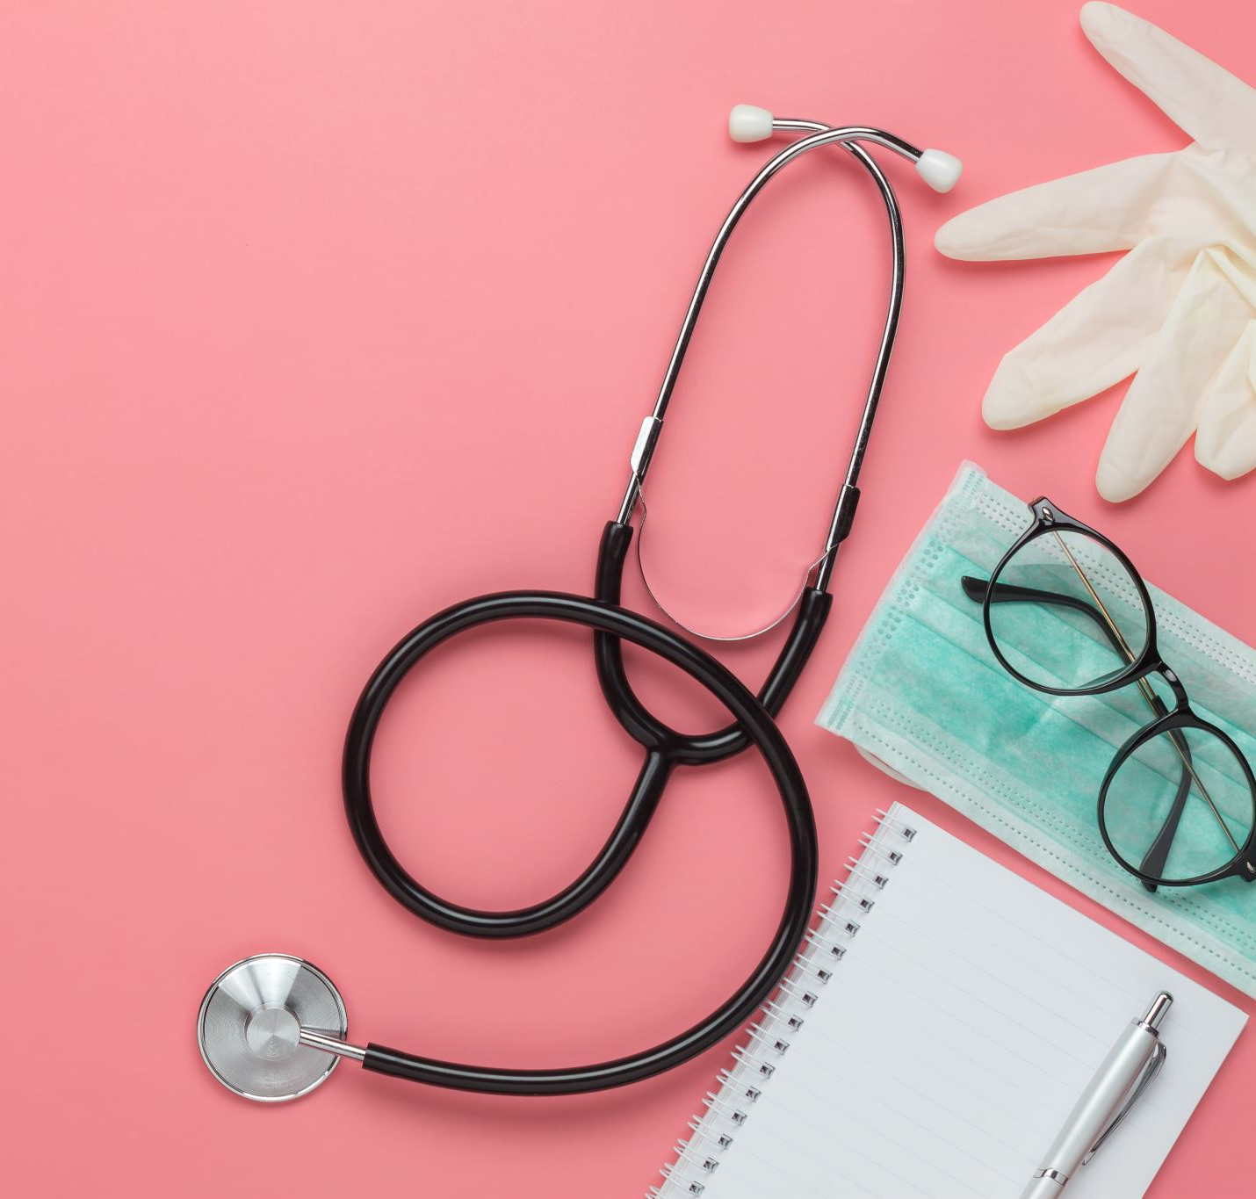
Overview
Introduction
  Stages in traditional drug discovery
  Current challenges in traditional drug development
AI pharmacogenomics and personalized medicine
Drug repurposing, AI and stages
Applications and scenarios
Challenges and drawbacks
Looking into the future
Conclusion

Slide 4
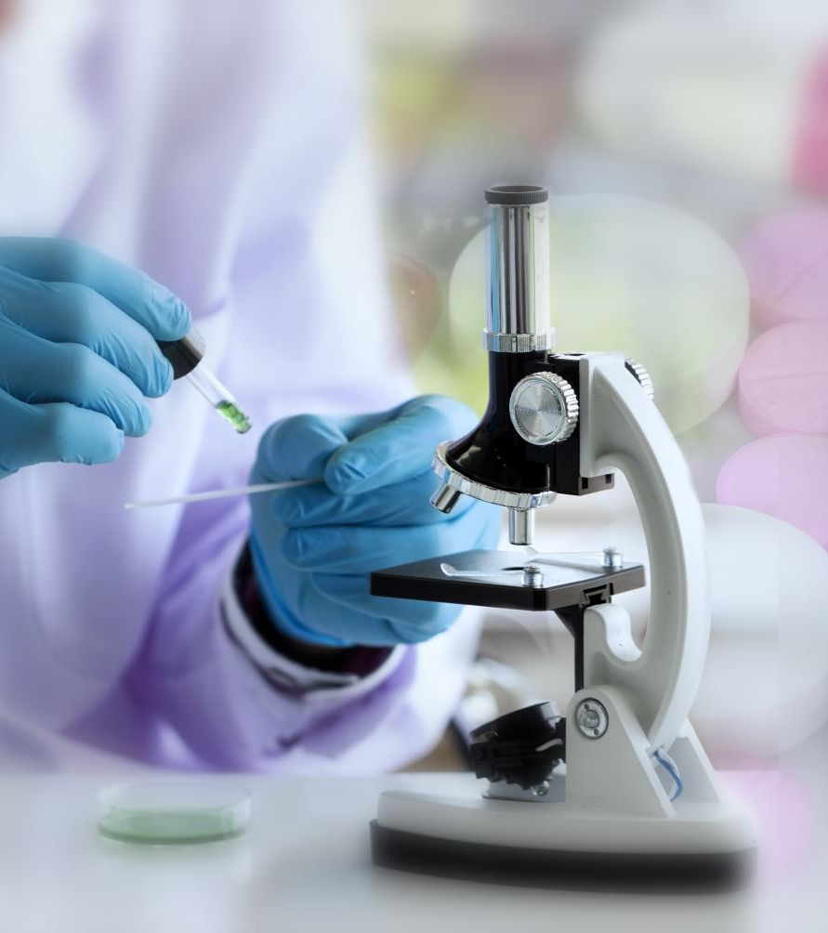
Introduction: Stages in drug discovery
Discovery and development;
Pre-clinical research;
Clinical research;
FDA review; and
FDA post-market safety monitoring and development

Slide 5
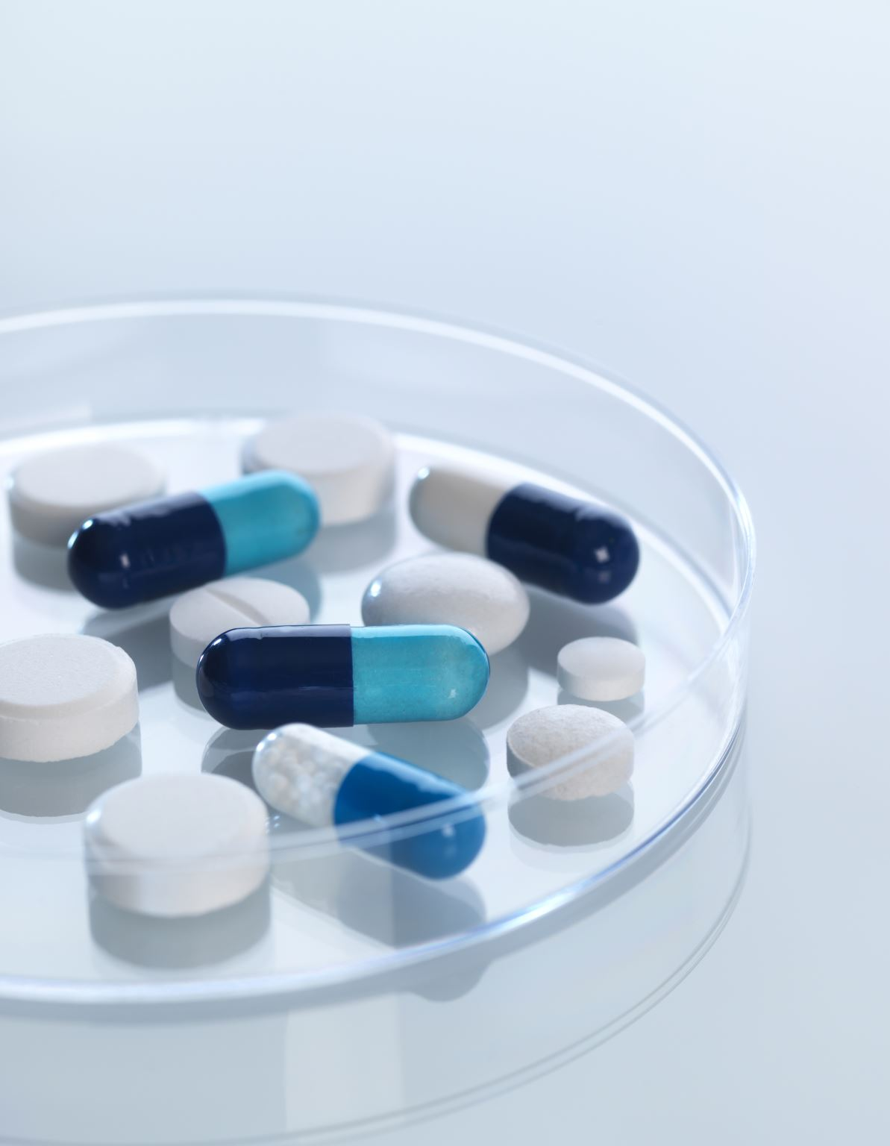
Current challenges to traditional drug development
High rate of molecule attrition-safety concerns
Cost of clinical trials
Timeline for drug discovery

Slide 6
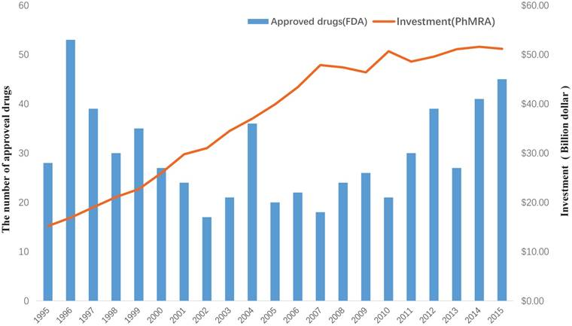
Cost for approved new drugs

Slide 7
AI, pharmacogenomics and personalized medicine
AI combines genomic information from next-generation sequencing approaches of thousands of diseased individuals with clinical information of disease characteristic traits and treatment outcomes
This potentially leads to the identification of treatment response-associated markers through a multi variate modeling procedure.
So, with detailed information on people’s genomic/proteomic data and their disease profile over time we can tell why one person responded to a medication better than the other.
Such information is bulky and complex and best processed by AI models that can stratify and prognosticate
Such genomic banks are already in use.

Slide 8
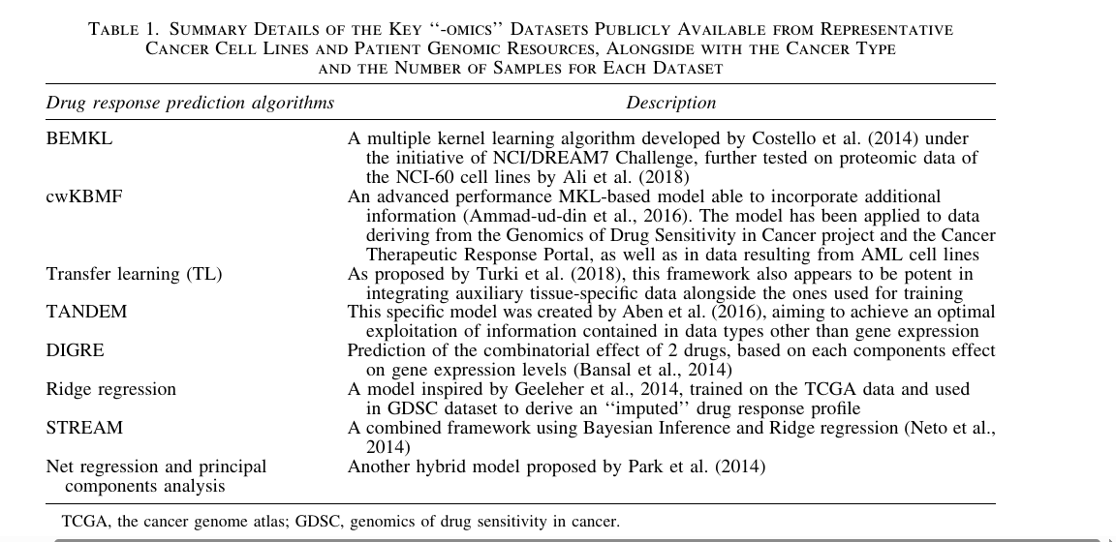

Slide 9
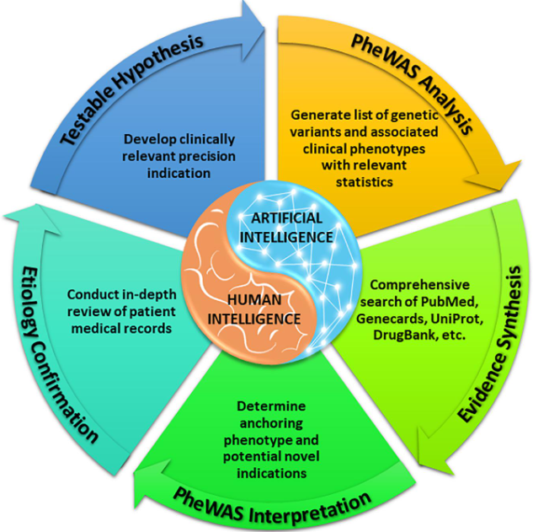
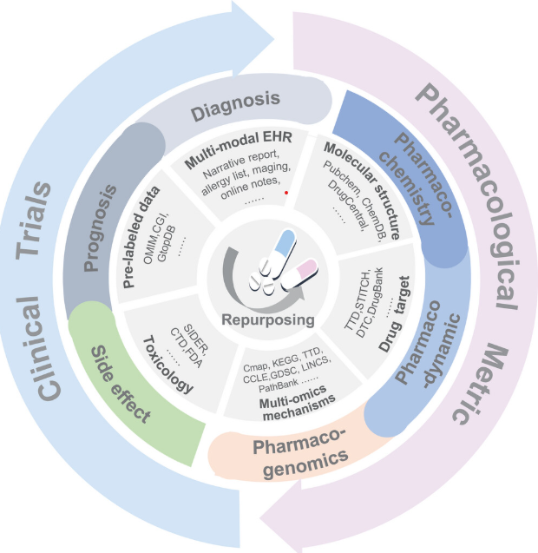
Wan, Zhaoman, et al. "Applications of Artificial Intelligence in Drug Repurposing." Advanced Science 12.14 (2025): 2411325.

Slide 10
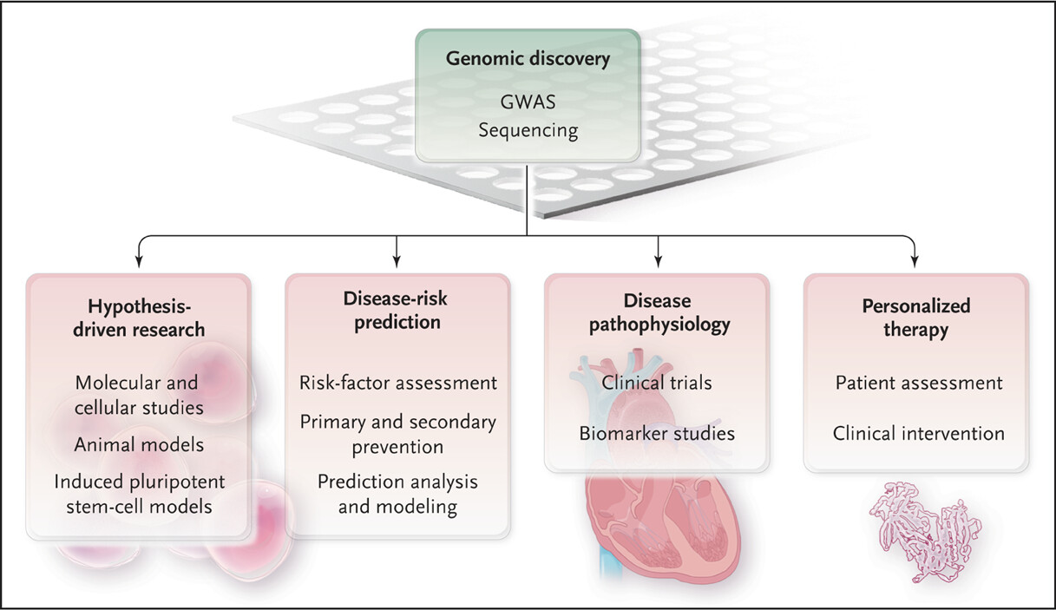
Omics in pathology and pharmacology: The new normal
Current global approach
Current Approach in Africa
Notes:
The worldview currently is up to down. Africa is down to up.

Slide 11
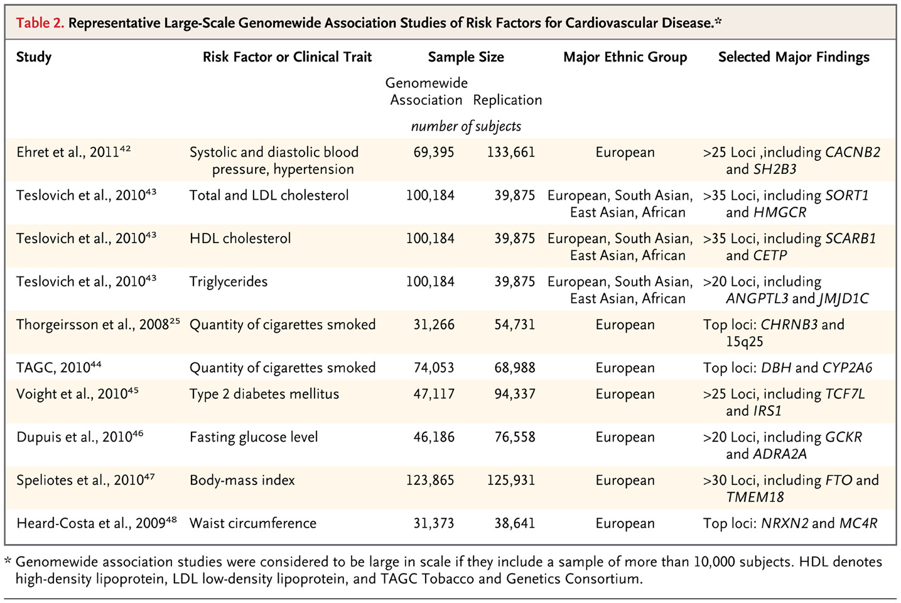
Europe 15 years ago
O’Donnell, C.J. (2011). Genomics of cardiovascular disease. New England Journal of Medicine, 2098–2109

Slide 12
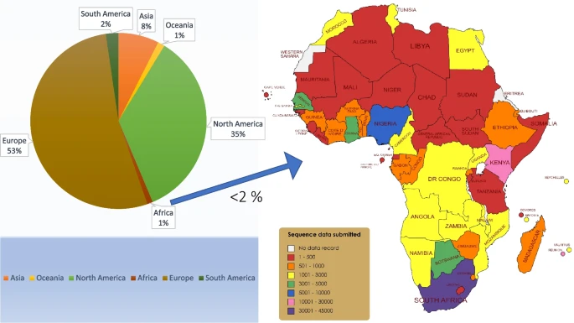
Bridging the Genomic gap
Omotoso, O.E., Teibo, J.O., Atiba, F.A. et al. Bridging the genomic data gap in Africa: implications for global disease burdens. Global Health 18, 103 (2022).
Notes:
https://doi.org/10.1186/s12992-022-00898-2

Slide 13
AI needs in Pharmacology
Drug discovery and development
Clinical decision making and patient care (treatment regimen, medication adherence, personalized medicine)
Manufacturing and design

Slide 14
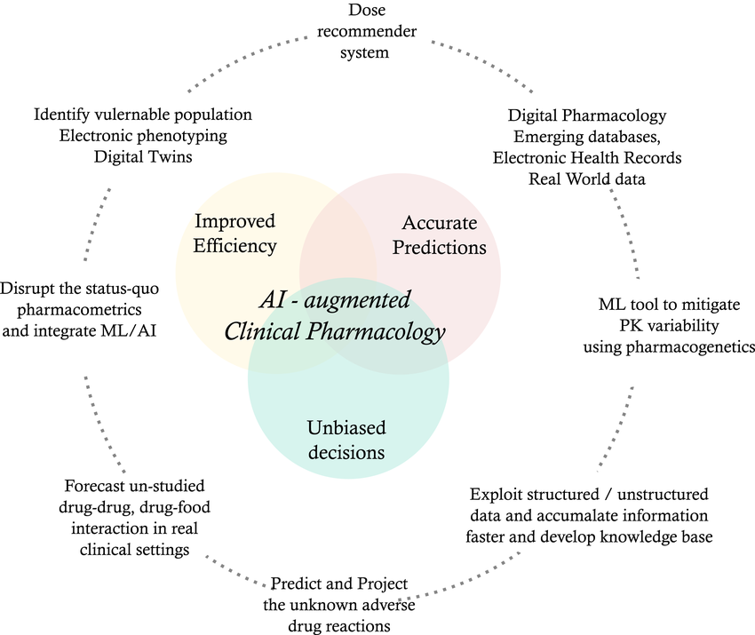
AI in Clinical pharmacology
Potential application of artificial intelligence and machine learning in clinical pharmacology. AI, artificial intelligence; ML, machine learning; PK, pharmacokinetics
Johnson, Martin, Mishal Patel, Alex Phipps, Mihaela Van der Schaar, Dave Boulton, and Megan Gibbs. "The potential and pitfalls of artificial intelligence in clinical pharmacology." CPT: Pharmacometrics & Systems Pharmacology 12, no. 3 (2023): 279.

Slide 15
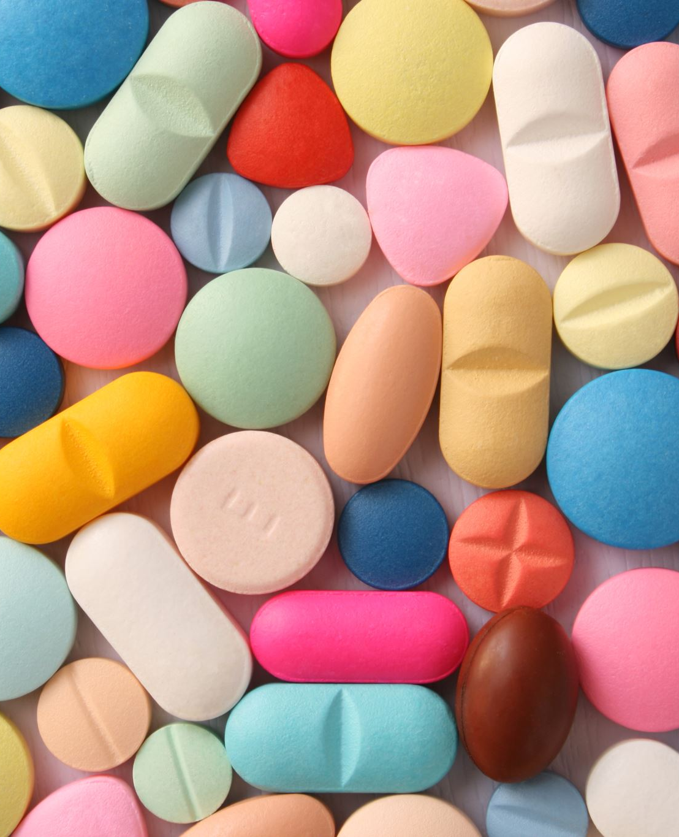
Concept of Drug repurposing
Drug repositioning (or drug repurposing or drug reprofiling ) can be defined as the process of selecting a known drug for an alternative pharmacological use.
The process of finding new uses for existing drugs.
It is a mathematical scheme to identify existing approved, archived, discontinued drugs or under clinical trials drugs to make use of treatment options for different or emerging diseases

Slide 16
Concept of Drug repurposing
The primary obstacle for the development of new chemical entities for new targets is not time, but the cost to bring a compound from the discovery phase to approval
Owing to the fast growth of bioinformatics knowledge and large-scale ‘‘-omics’’ data, drug repositioning has decreased significantly the time cost for the drug development process.
Nowadays, researchers only need *1–2 years to identify new potential drug targets.

Slide 17

What is Drug Repurposing?
• New therapeutic uses for existing drugs
• Utilizes known safety and efficacy
• Reduces time and cost

Slide 18
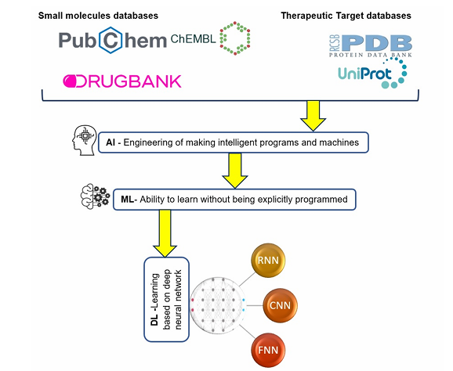
Selvaraj et al. Current Chinese Science, 2021, Vol. 1, No. 3

Slide 19
example
Thalidomide, initially developed and used as a treatment for morning sickness in pregnant women, was withdrawn from the market due to its teratogenic effects
However, subsequent research revealed its efficacy in treating multiple myeloma and leprosy, leading to its reintroduction in clinical practice
Sildenafil, which was originally investigated for cardiovascular diseases but was later repurposed and marketed under the brand name Viagra for the treatment of erectile dysfunction
Minoxidil, originally approved as an antihypertensive agent, was repurposed for the treatment of alopecia due to its hair growth-promoting effects observed during clinical trials

Slide 20
Why AI in Drug Repurposing?
Traditional methods: slow, costly
AI: predictive, low-cost, scalable
Uncovers hidden drug-target patterns
Integrates real-world and omics data
The high cost is partly due to the high rate of attrition in clinical trials, particularly in the later development phases.
About two-thirds of failures are not due to lack of efficacy or safety, but for commercial reasons, like low potential market, unwanted profile in comparison with other products, or adverse cost-effectiveness

Slide 21
A 2016 report on drug development sustainability by the Deloitte Centre for Health Solutions reports an average of 15 years spent on drug discovery and development at costs of $2.558 billion
The financial investment is extensive, with severe implications for negative phases involving "drug safety and efficacy" causing over 90% failures
This high productivity threshold (96%) raises questions on the effectiveness of modern medicine and the level of toxicity to be tested
Artificial intelligence (AI) offers an array of solutions designed to cater to the aforementioned research problems of drug repurposing, resulting in significant reductions in drug discovery costs

Slide 22
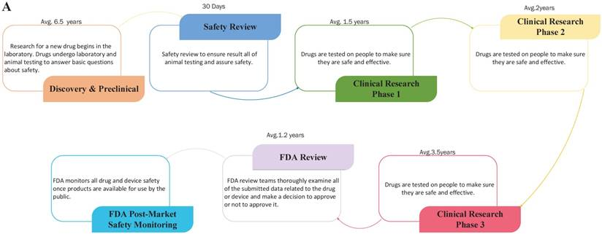
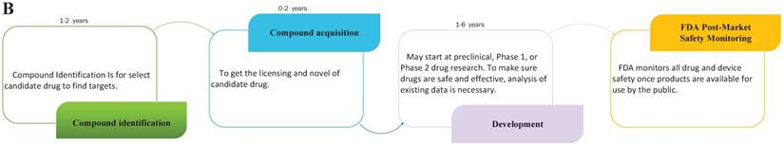
Traditional drug development
Drug repurposing
Xue, H., Li, J., Xie, H., Wang, Y. (2018). Review of Drug Repositioning Approaches and Resources. International Journal of Biological Sciences, 14(10), 1232-1244. https://doi.org/10.7150/ijbs.24612.

Slide 23
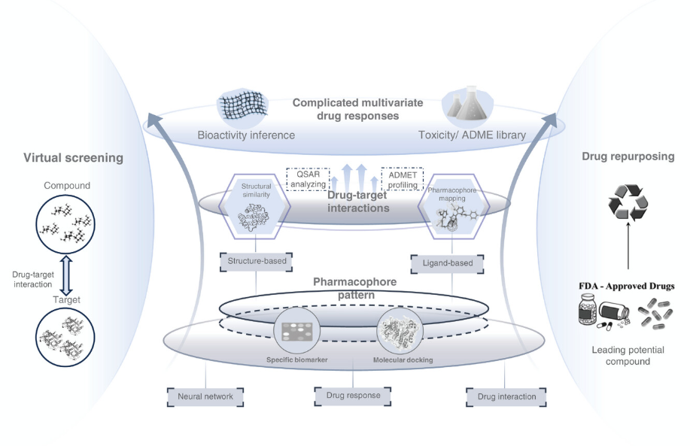
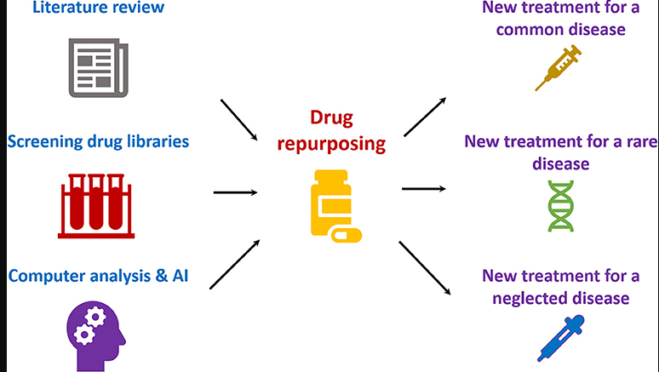

Slide 24
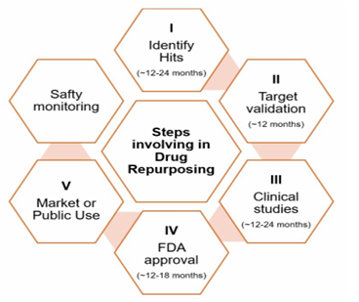
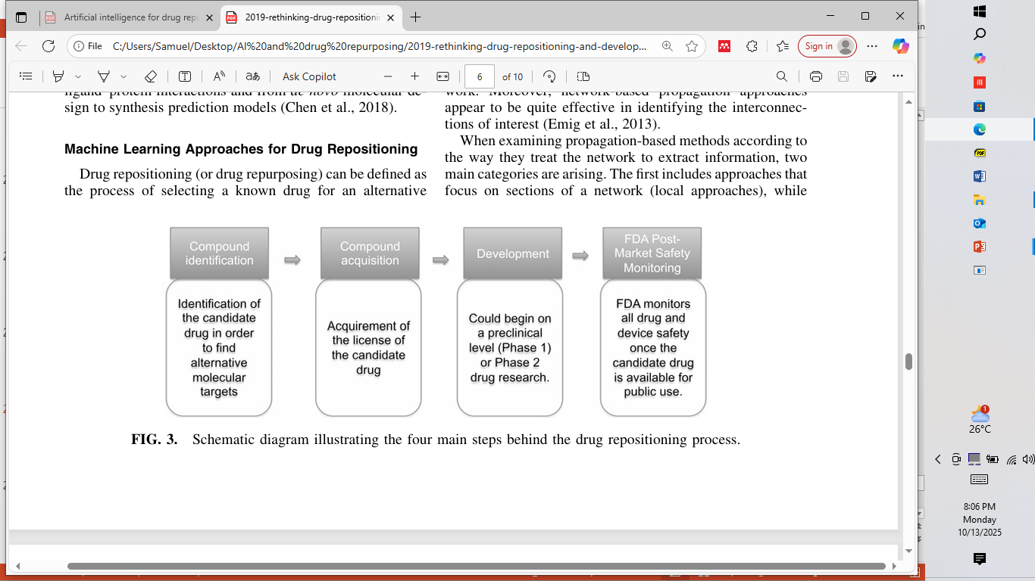
Steps in drug repurposing/repositioning
2019 rethinking

Slide 25
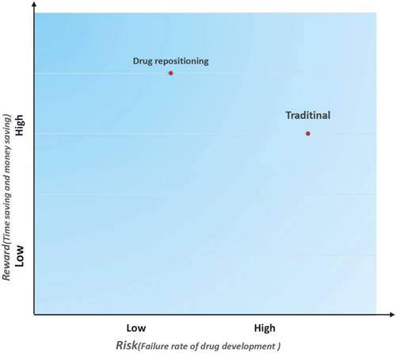

Slide 26
AI Capabilities
Pattern recognition and prediction
Data integration
Virtual screening and modeling
Decision support systems

Slide 27
Drug repositioning approaches
Majority of the existing computational approaches used in drug repositioning are based on gene expression response data of different cell lines after drug treatment.
In summary, drug repositioning approaches can be divided into three categories: network-based approaches, text-mining approaches, and semantic approaches.

Slide 28
Network-based methods
This can be divided into:
  Clustering-search for relationships between drugs and diseases or putative targets into smaller clusters within a bigger network
  Propagation approach-based on the flow of previously acquired knowledge through the different layers of a net work
network-based propagation approaches appear to be quite effective in identifying the interconnections of interest
  Used to identify patterns,
  functionally associated proteins,
  and novel drug-disease or drug-target relationships
Have been used to predict c-myc target for melanoma, and could predict unknown causal genes of some diseases such as type 2 diabetes, Alzheimer’s disease and prostate cancer

Slide 29

Text mining approach
Exploits the vast amount of available literature
Filters the search to retain only the relevant sources to extract knowledge for a set of biological terms of interest
The main pipeline of biological text mining includes four phrases:
information retrieval (IR),
biological name entity recognition (BNER),
biological information extraction (BIE) and
biological knowledge discovery (BKD

Slide 30
At the same time, potential associations between knowledge, such as drug-disease and drug-target relationships, can also be detected
The origin of text mining methods in the medical field is the Swanson ‘ABC’ model,
  which states that if concept A is connected with concept B, and concept B is involved with concept C, then concept A may have a novel connection with concept C

Slide 31
Semantics-based approaches
the creation of networks is guided from prior biomedical knowledge extracted from databases
Machine learning algorithms are utilized to identify new interactions and relationships, which are present in these networks

Slide 32
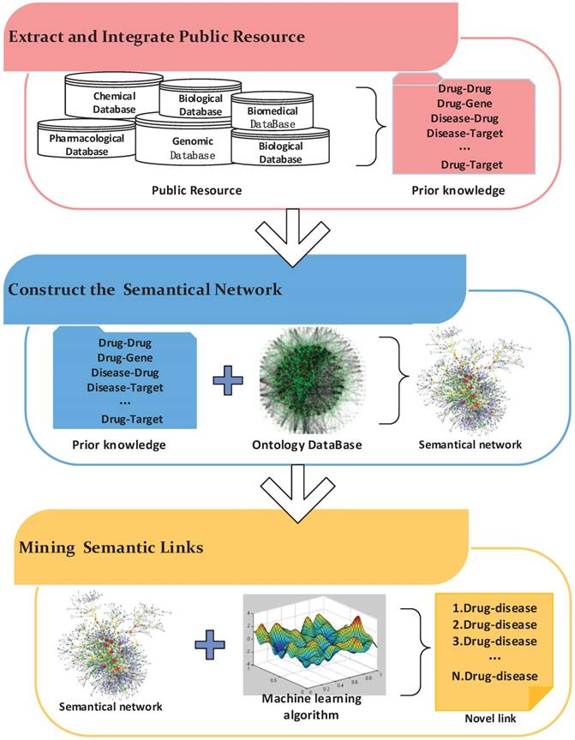

Semantic approach
Text mining approach
Xue, H., Li, J., Xie, H., Wang, Y. (2018). Review of Drug Repositioning Approaches and Resources. International Journal of Biological Sciences, 14(10), 1232-1244. https://doi.org/10.7150/ijbs.24612.

Slide 33
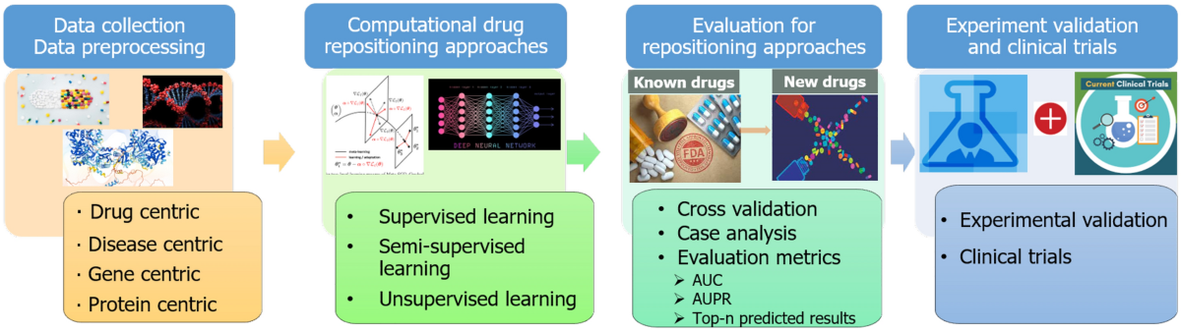
Computational approach
Yang, F., Zhang, Q., Ji, X. et al. Machine Learning Applications in Drug Repurposing. Interdiscip Sci Comput Life Sci 14, 15–21 (2022). https://doi.org/10.1007/s12539-021-00487-8

Slide 34
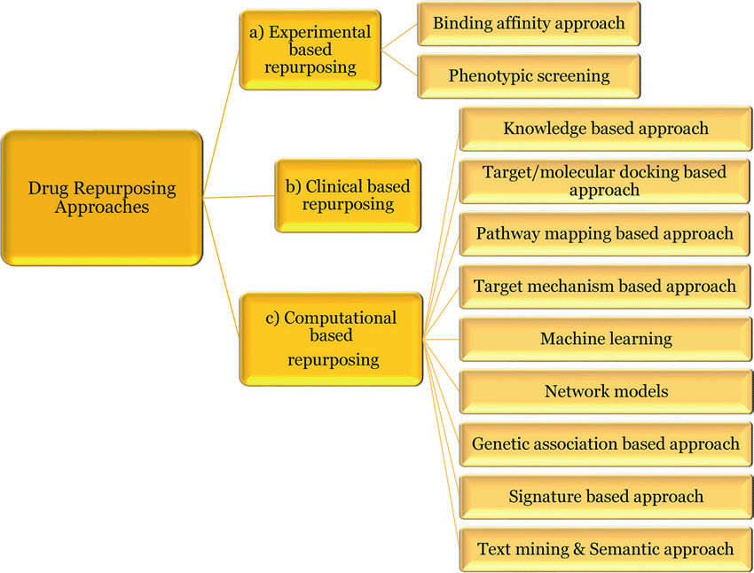
Other Drug repositioning approaches
Dhir, Neha & Jain, Ashish & Mahendru, Dhruv & Prakash, Ajay & Medhi, Bikash. (2020). Drug Repurposing and Orphan Disease Therapeutics. 10.5772/intechopen.91941.

Slide 35
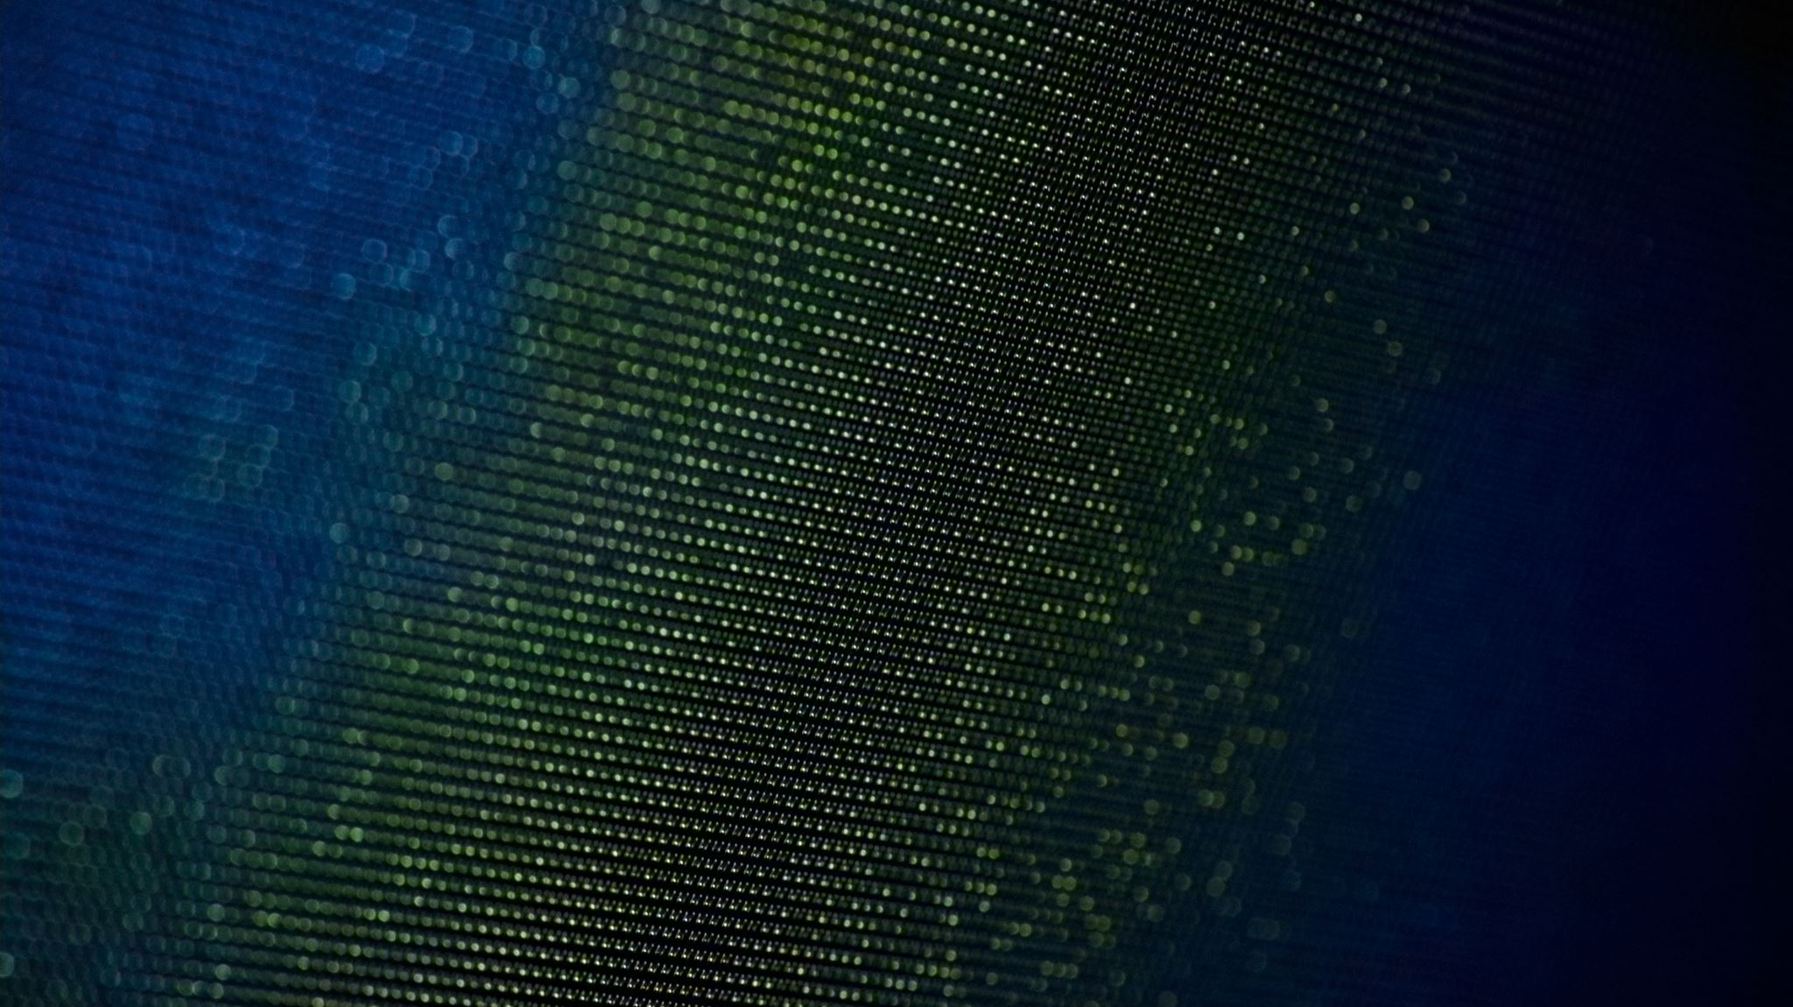
Examples
The uncovering of the Proprotein convertase subtilisin/kexin type 9 (PCSK9)association with heart disease-New guideline directed therapy in dyslipidemia uses PCSK9 inhibitor.
Suramin and glioblastoma
New targets for Alzheimers using diltiazem and quinidine

Slide 36
Drug Screening Workflow
Compound → Target → Interaction → Response → Repurposed drug
AI enhances each stage

Slide 37
Data Foundations
• Databases: PubChem, ChEMBL, DrugBank
• Integrative datasets: GDSC, CTD, LINCS L1000
• Challenges: heterogeneity, missing data

Slide 38
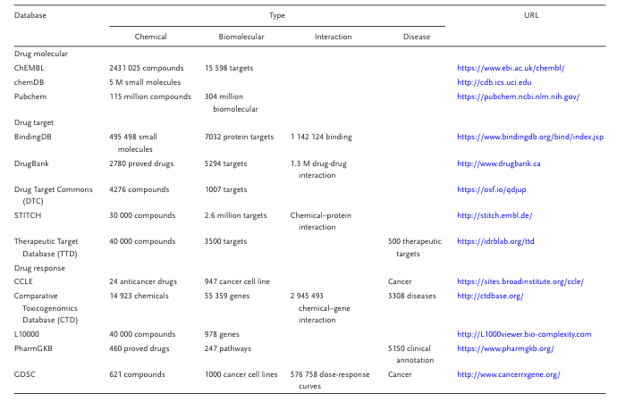

Slide 39
AI Tools and Models
Machine Learning (ML)
Deep Learning (DL)
Natural Language Processing (NLP)
Reinforcement Learning (RL)

Slide 40
Machine learning (ML) for drug repurposing
ML algorithms are capable of processing and analyzing billions of data points within a dataset to uncover patterns, correlations, associations, and dependencies among various drug features, disease characteristics, biological mechanisms, and real-world evidence from published scientific literature .
They typically focus on drug treatments for a specific disease.
Ability to predict repurposing of a drug according to single drugs compassing known association with a target disease or for even multiple drugs that have not been tested experimentally.

Slide 41
Linking Drugs and Targets
Supervised learning (SVM, regression)
Unsupervised clustering
GANs for molecular generation

Slide 42
Neural Networks in Repurposing
RNNs: time-series drug response
CNNs: protein-ligand modeling
MLPs: multidimensional data

Slide 43
Natural Language Processing
• Extract insights from text and EHRs
• Models: BERT, GPT, Word2Vec
• Identify relationships and indications

Slide 44
AI and drug repositioning
The integration of AI in drug repurposing has led to the development of sophisticated computational methods that can analyze diverse data types, including genomics, electronic health records, and chemical informatics
AI approaches can be of great help in essentially every step of the rigorous drug design and development process.
Starting from screening of vast compound libraries, hit discovery, and lead identification to exploring the possible modifications that lead to compounds with improved pharmacokinetic, pharmacodynamic, and toxicological characteristics, planning the synthetic route to follow is usually through retrosynthesis.

Slide 45
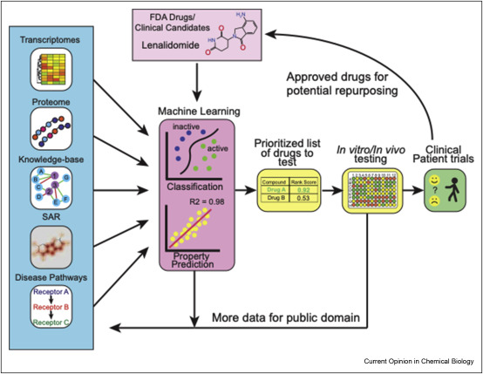
Urbina, F., Puhl, A.C. and Ekins, S. (2021) ‘Recent advances in drug repurposing using Machine Learning’, Current Opinion in Chemical Biology, 65, pp. 74–84. doi:10.1016/j.cbpa.2021.06.001.

Slide 46
Deep learning
DL has gained remarkable attention in various fields recently, mainly due to its ability to view data in a layered manner.
It is usually implemented as a neural network model with tens or even hundreds of layers.
Such a network can form representations of data at different levels of granularity, which is a crucial ability in the analysis of the complex and diverse CW datasets.
In drug repurposing, DL uses a vast number of layers to automatically extract highly optimized and complex features from diverse biological and chemical data.
Despite its notable success in biological and chemical applications, training deep neural nets is quite challenging in terms of the large number of parameters and data requirements.

Slide 47
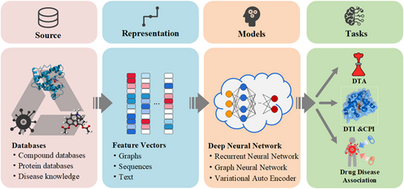
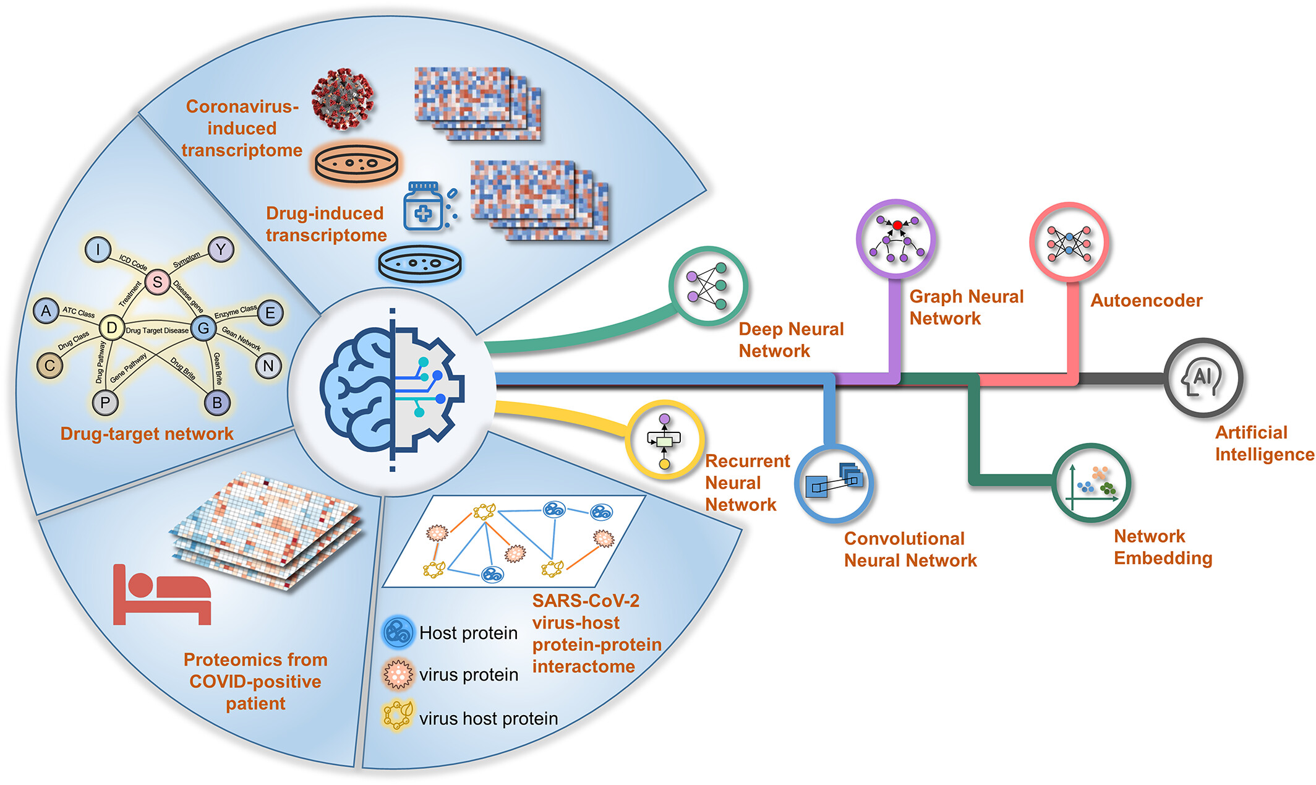
Deep learning model
Pan X, Lin X, Cao D, Zeng X, Yu PS, He L, et al. Deep learning for drug repurposing: Methods, databases, and applications. WIREs Comput Mol Sci. 2022; 12:e1597. https://doi.org/10.1002/wcms.1597

Slide 48
AI in Real-World Data
Analyzes EHRs and clinical records
Maps molecular data to outcomes
Enhances therapy optimization

Slide 49
Application Scenarios
Transforming side effects into opportunities
Exploring new indications
Identifying new targets
Integrating AI with real-world data

Slide 50
Side Effects as Opportunities
Reveal therapeutic potential
Example: Aspirin repurposing
AI detects omics-based associations

Slide 51
Exploring New Indications
Based on shared mechanisms
Uses high-throughput screening
Connectivity mapping studies

Slide 52
Discovering New Targets
• Molecular docking, graph networks
• Tools: AutoDock, Glide, AlphaFold2
• Predicts novel drug-target interactions

Slide 53
Integrating AI + Real-World Data
• Correlates chemical and clinical data
• Predicts drug–disease links
• Safer, faster repurposing

Slide 54
Interventional Pharmacology
• AI-driven PBPK/QSAR models
• Predict nanoparticle drug delivery
• ADR risk prediction

Slide 55
Electronic Health Records (EHR)
• Mine data for repurposing
• Detect interactions and outcomes
• Supports pharmacovigilance

Slide 56
Challenges
• Data heterogeneity
• Black-box model interpretability
• Computational resource limits
• Regulatory validation

Slide 57
Drawbacks-Interpretability
AI models, especially deep learning, can be difficult to interpret, making it hard to understand how they reach their conclusions.
This "black box" nature can hinder clinical acceptance, as clinicians need to understand the rationale behind treatment decisions.
Regulatory bodies also demand explanations for AI predictions, which can be challenging to provide if the model's decision-making process is opaque

Slide 58
Drawbacks-Data Quality and Availability Issues:
AI algorithms require large, high-quality datasets for training, but such datasets may be limited in certain areas, especially for rare diseases.
Data can also be biased, either intentionally or unintentionally, leading to inaccurate or harmful predictions
Incomplete or inconsistent data can also affect the accuracy and reliability of AI predictions

Slide 59
Drawbacks-Ethical and Regulatory Concerns
Data privacy and security are major concerns, as AI models may inadvertently collect and store sensitive data
Ethical considerations regarding the use of AI in healthcare, such as algorithmic bias and fairness, need to be addressed
Regulatory hurdles can be significant, especially for drug repurposing, where strict validation and approval processes are required

Slide 60
Drawbacks-Cost and Expertise
Implementing and maintaining AI systems in drug repurposing can be expensive, requiring specialized expertise in both AI and pharmaceutical sciences.
The cost of data acquisition, model development, and validation can be substantial.
The need for specialized personnel can also be a barrier to adoption

Slide 61
Drawbacks-Data integrity & Framework
The success of AI-based drug repurposing tools is subject to the quality and consistency of the data they utilize
computational drug repurposing comes with significant challenges. For example, identification of suitable candidates demands a profound understanding of the molecular mechanisms underpinning diseases.
the absence of a clear regulatory framework tailored to the distinctive challenges of drug repurposing has hampered its widespread adoption

Slide 62
Overcoming Challenges
• Data harmonization
• Explainable AI models
• Collaborative open platforms

Slide 63
Where is all this heading
matching patients with specific repurposed drugs based on individual characteristics, such as genetic profiles or molecular markers

Slide 64

Future of AI in Repurposing
• Personalized and precision medicine
• AI-based patient stratification
• Genomic and proteomic integration

Slide 65
AI + Personalized Medicine
• Tailored treatment via AI analytics
• Predict efficacy and safety
• Ethical and privacy concerns

Slide 66
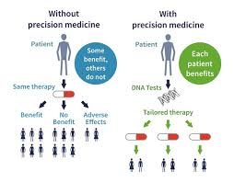
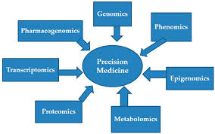
Personalized medicine

Slide 67
Key Takeaways
• AI enhances efficiency and safety
• Integrates data for new insights
• Accelerates discovery process

Slide 68
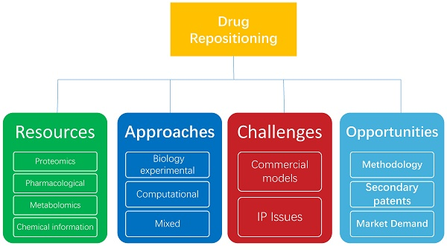
Conclusion

Slide 69

Thanks for the Audience

Slide 70
References
1. Wan, Zhaoman, et al. "Applications of Artificial Intelligence in Drug Repurposing." Advanced Science 12.14 (2025): 2411325.
2. O’Donnell, C.J. (2011). Genomics of cardiovascular disease. New England Journal of Medicine, 2098–2109
3. Omotoso, O.E., Teibo, J.O., Atiba, F.A. et al. Bridging the genomic data gap in Africa: implications for global disease burdens. Global Health 18, 103 (2022).
4. Xue, H., Li, J., Xie, H., Wang, Y. (2018). Review of Drug Repositioning Approaches and Resources. International Journal of Biological Sciences, 14(10), 1232-1244. https://doi.org/10.7150/ijbs.24612.
5. Johnson, Martin, Mishal Patel, Alex Phipps, Mihaela Van der Schaar, Dave Boulton, and Megan Gibbs. "The potential and pitfalls of artificial intelligence in clinical pharmacology." CPT: Pharmacometrics & Systems Pharmacology 12, no. 3 (2023): 279
6. Selvaraj et al. Current Chinese Science, 2021, Vol. 1, No. 3

Slide 71
References
7. Yang, F., Zhang, Q., Ji, X. et al. Machine Learning Applications in Drug Repurposing. Interdiscip Sci Comput Life Sci 14, 15–21 (2022). https://doi.org/10.1007/s12539-021-00487-8
8. Dhir, Neha & Jain, Ashish & Mahendru, Dhruv & Prakash, Ajay & Medhi, Bikash. (2020). Drug Repurposing and Orphan Disease Therapeutics. 10.5772/intechopen.91941.
9. Urbina, F., Puhl, A.C. and Ekins, S. (2021) ‘Recent advances in drug repurposing using Machine Learning’, Current Opinion in Chemical Biology, 65, pp. 74–84. doi:10.1016/j.cbpa.2021.06.001.
10. Pan X, Lin X, Cao D, Zeng X, Yu PS, He L, et al. Deep learning for drug repurposing: Methods, databases, and applications. WIREs Comput Mol Sci. 2022; 12:e1597. https://doi.org/10.1002/wcms.1597

